Slide 1
Principles of Removable Partial Denture Design
Dalhousie University

Slide 2
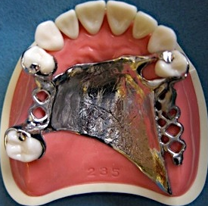
Basic Principles

Slide 3
No Treatment Prior to
RPD Design Approval!
Emergency Treatment Only
RPD design part of Treatment Planning
Draw design RPD on surveyed cast FIRST
Can affect restorations
Can affect Crown/Preparatio

Slide 4
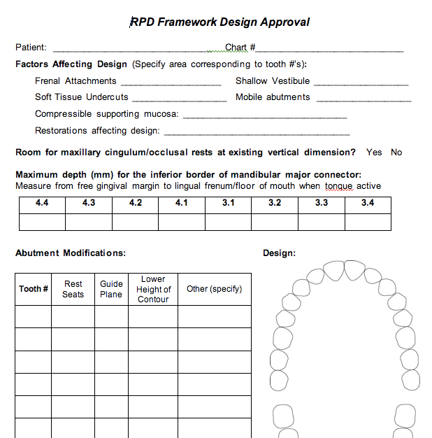

Slide 5
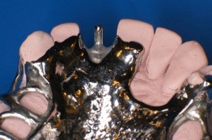
Minimize Tissue Contact
✗
Minimal coverage soft & hard tissues
Avoid plating unless unavoidable
✔

Slide 6
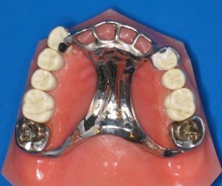
Whenever Possible, Avoid Plating
More plaque, bleeding, loss of attachment, root caries when framework near or covering gingival margins
Yeung et al, J Oral Rehab 2000
Budtz-Jorgensen, Quintess 1999
Jacobson, Compend 1987
Chandler & Brudvik, JPD 1983
Runov et al, J Oral Rehab 1980,
Brill, JPD 1977, etc
More comfortable
Prefer Ling bar: Ling plate 3:1
Campbell JPD 1977
✗
✔

Slide 7
Optimizing Periodontal Health with RPD’s
Hygienic RPD design
OHI, yearly maintenance & patient compliance
Long term periodontal health is feasible
Bergman et al, 25 year longtitudinal study (1971-1995)
Baseline assessment & yearly maintenance
63% of survivors still wearing same RPD
No change in periodontal status

Slide 8
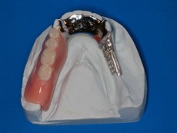
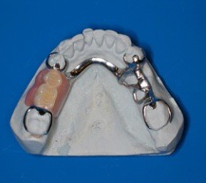
Minimize components
Improved hygiene with simple shapes & fewer components
Jacobson, Compend 1987
Budtz-Jorgensen, Quintess 1999
Runov et al, J Oral Rehab 1980,
Brill, JPD 1977, etc
Minimize indirect retainers - effectiveness is controversial
✗
✔

Slide 9
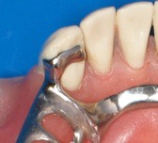
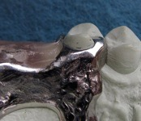
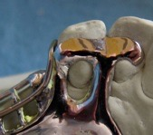
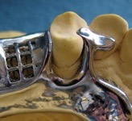
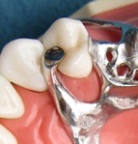
Minimize Framework Elements
Cingulum rests join proximal plates, rather than having separate minor connectors, whenever possible
✘ ✘ ✔ ✔

Slide 10
Utilize What’s Present
Select design that fits hard & soft tissues, rather one that requires tissue alteration
If rest seats present, use them

Slide 11
Plan for the Future
Partial denture can be adapted if abutment is lost
Design crowns with rest seats and guiding planes

Slide 12
Don’t Design Using Cast Alone
Can’t assess:
abutment mobility
compressibility of mucosa
floor of mouth, prominent frena
occlusion
Check tissues intraorally
Mounted models to assess occlusion

Slide 13
Rests
Ensure sufficient rest seat depth/clearance (1.5mm)
Avoid incisal rests
Poor esthetics
Increased tilting
Use bonded cingulum rest, if no prominent cingulum

Slide 14
Avoid Rests on Restorations
If possible (not always)
Ensure adequate bulk, retention
If restoration fails, restoration will be more complex, expensive

Slide 15
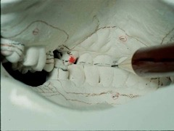
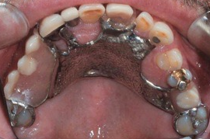
Avoid Rests in Areas of Heavy Occlusal Contact
Extruded, tilted teeth
Check for clearance for maxillary cingulum rests (intraorally, and on cast)

Slide 16
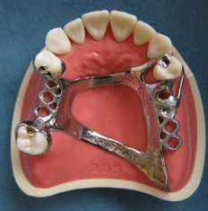
Rests
Tooth Borne (Cl III & IV)
adjacent edentulous space
Tissue Borne (Cl I & II)
mesial preferred, except if:
restoration
tilted (access)
heavy occlusal contact

Slide 17
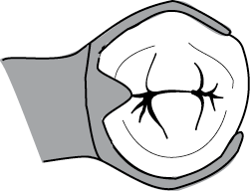
Direct Retainers Cl III & IV
Clasp of Choice: Cast Circumferential
If can’t use tooth next to edentulous space: Double Embrasure
If Tilted:
Cast Circumfertial with lingual retention
Ring Clasp

Slide 18
Direct Retainers
Cl I & II
Clasp of Choice: RPI
If no room for I-bar: RPA
If mesial rest not possible:
Combination Clasp

Slide 19
Rationale for RPI as Clasp of Choice
Cl I & II
Esthetics
hidden by lip
Hygiene
just tip of clasp contacts tooth
Stress Release

Slide 20
How RPI Reduces Stress
Whole retainer rotates less
Retentive clasp disengages from tooth

Slide 21
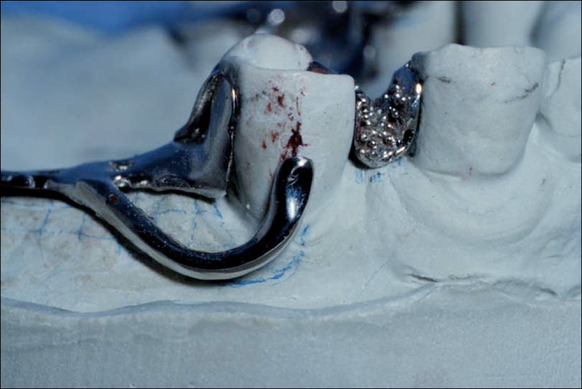
I-bars
Gently curve from gridwork
Originate from gridwork posterior to 1st replacement tooth
Do not use L-bars (less flexible)
Do not flatten retentive tip
✔
✗

Slide 22
Direct Retainers
Minimize need for direct retention
Broad, intimate denture base adaptation
Use of minor soft tissue undercuts
Guiding planes
Indirect retainers

Slide 23
Circumferential Clasps
Design Retentive Arm Correctly
Incorrect
S-shaped
Incorrect
Too Straight
Correctly Designed
But below H of C
- lower height of contour

Slide 24
Retentive Undercuts
If retentive tip too close to gingiva:
Prepare undercut (move clasp higher)
Add composite resin to raise height of contour
Must be marked!

Slide 25
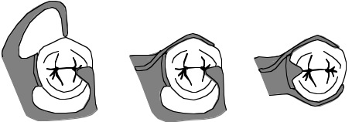
Abutment Mobility
Use stress releasing retainers
More load transferred to residual ridge
RPA
Combination Clasp
RPI

Slide 26
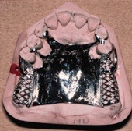
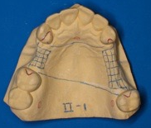
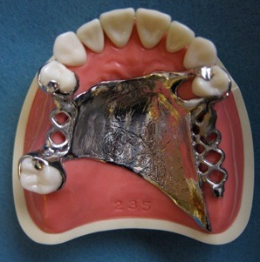
Indirect Retainers
Class I & II
As far from primary fulcrum as possible (90°)
Normally not required for tooth borne RPD’s
Don’t use if a direct retainer elsewhere will provide indirect retention

Slide 27
Number of Direct Retainers
4 - Greatest amount of retention
(e.g. Cl. III, mod 1)
Clasps can be omitted, if supplemental retention is substituted
3 - Less retentive, (Class II)
2 - Absolute minimum (Class I)

Slide 28
If Omit a Direct Retainer
Find some other factor to substitute for missing retention
Long guideplanes
Many guideplanes
More soft tissue coverage
Use soft tissue undercuts

Slide 29
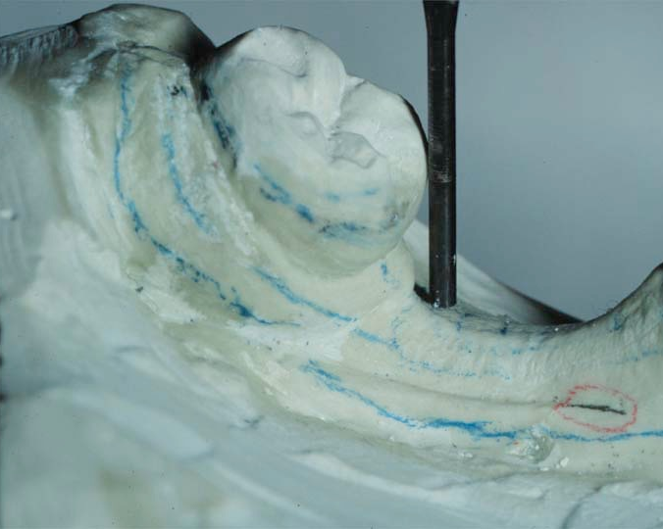
The Tilted Posterior Abutment
If severe - possible extraction, orthodontic uprighting
If moderate - heavy guide planes
prevent food impaction, hygiene problems
so clasp arms can be placed lower
comfort
prevent occlusal interference

Slide 30
Major Connectors
Assess tori, height of floor of mouth, frenal attachments, which may affect major connector choice

Slide 31
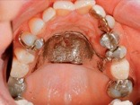
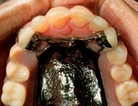
Major Connectors
Maxilla
Tooth borne: Palatal Strap
Distal Extension
A-P Strap
Full palatal plate if extensive, or need extra stability or retention

Slide 32
Point to Hamular Notch
Only on a side where butting with acrylic
Where denture base terminating in hamular notch
i.e. distal extension side ONLY!
No
Yes

Slide 33
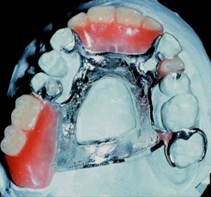
Maxillary Major Connectors
Posterior extensions of distal extension framework should point to hamular notches

Slide 34
Major Connectors
Mandible
Lingual Bar if possible
Lingual Plate if:
High frenum, floor of mouth
Want to stabilize teeth
May need to add teeth to partial
Want to avoid torus

Slide 35
Distal Extension Bases
Extended to :
Retromolar pads
Hamular Notches

Slide 36
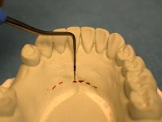
Mand. Major Connector
ALWAYS measure distance for inferior border from FGM

Slide 37
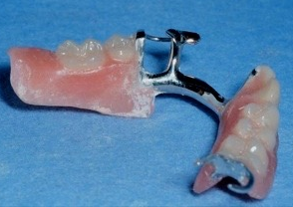
Major Connectors
Avoid abrupt changes of contour or bulky contours, particularly at junctions with the acrylic denture bases

Slide 38
Minor Connectors
Unless using plating, do not wrap cingulum rest minor connectors into embrasures
Correct
Incorrect

Slide 39
Consider Soft Tissue Variables
Frenal Attachments
Vestibular depth / undercuts
Mark extent on cast
Compressibility of attached mucosa

Slide 40
Consider Hard Tissue Variables
Opposing occlusion (mark)
Tori
Access to embrasures
Positions of undercuts
Mobilities
Restorations

Slide 41
Design Sequence
Identify primary abutment(s) (adjacent edentulous spaces)
Identify if abutment(s) needed for indirect retention in Cl I & II cases (only if required)
Select a path of insertion
Determine rest position
Select direct retainers
Select major connector
Select minor connectors

Slide 42
Drawing the Design
Red
Retentive undercut
Wrought wire arms
Blue
All other elements
WW Retentive undercut

Slide 43
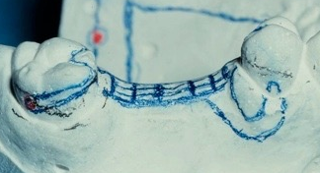
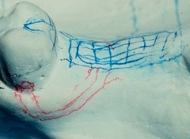
Drawing the Design
Absolute Accuracy
Technician to place elements in proper position & proportions

Slide 44
Drawing the Design
Absolute Accuracy
Single distinct lines
No guessing involved

Slide 45
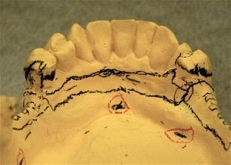
How to Improve?
Just not neat enough
Tripod marks too close to each other, not clear

Slide 46
Major Connector
Keep away from FGM at posterior
Do NOT plate unless necessary

Slide 47
How to Improve?
Too ‘Sketchy’
Major connector too close to FGM #3.4, 3.5

Slide 48
Tripod Marks
Keep away from design lines
Mark with carbon marker, circle in red

Slide 49
No I-bars if Interferes with Soft Tissues
Frenal attachments, Shallow Vestibule

Slide 50
How to Improve?
No S-shaped clasps

Slide 51
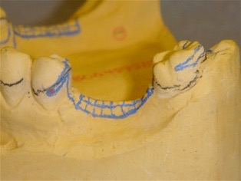
How to Improve?
Clasps too short, too straight
Drawing accurately counts!

Slide 52
How to Improve?
Major Connector way too narrow
Proportions count!

Slide 53
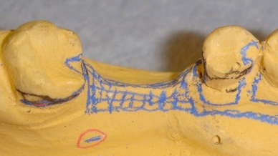
How to Improve?
Tooth borne RPD’s or modification spaces
Rests adjacent edentulous space
No mesial rest #35

Slide 54
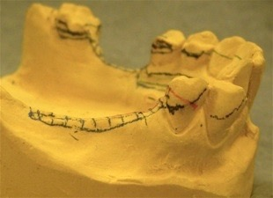
How to Improve?
Clasp arm too high

Slide 55
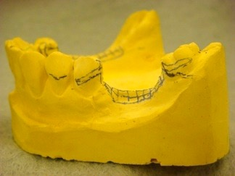
How to Improve?
Arm too straight

Slide 56
How to Improve?
Arms too thick
Arms too high

Slide 57
Border Contours
No sharp edges unless acrylic junction

Slide 58
Drawing
Be neat and in proportion
I-bar too thick

Slide 59
Major Connectors Contact with Abutments
No tiny strut from abutment to grid work or major connector
Yes
No

