Slide 1
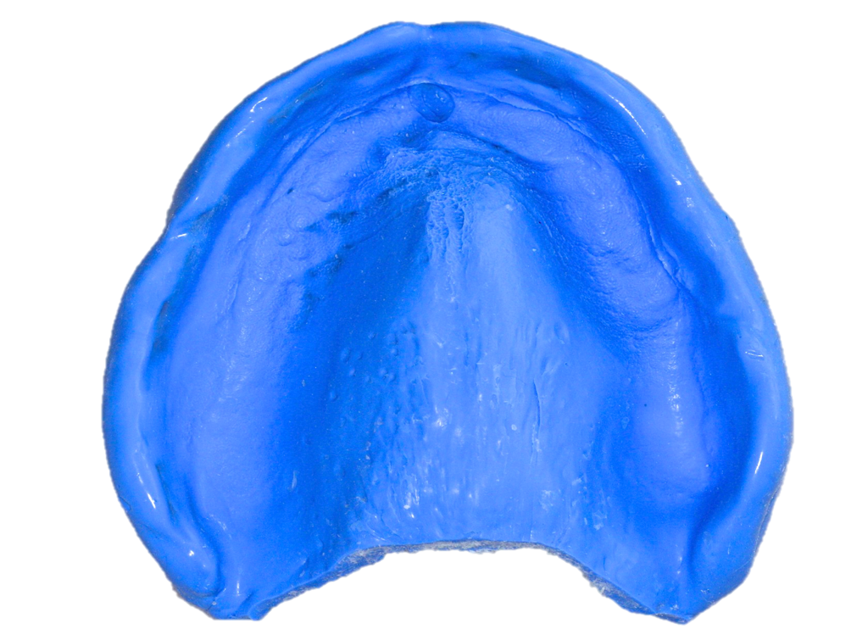
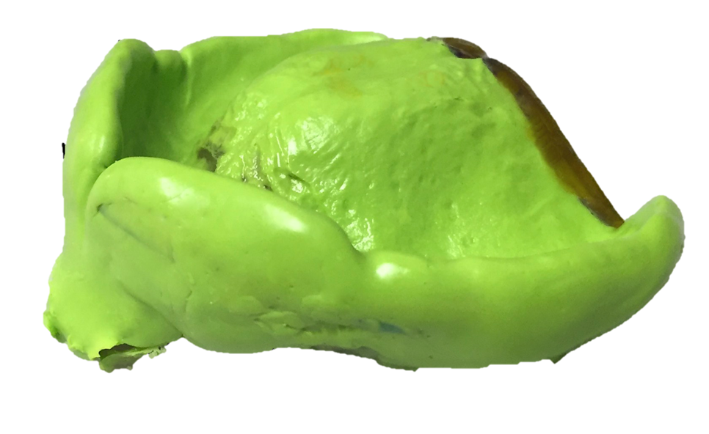
Final Impressions for
Complete Dentures

Slide 2
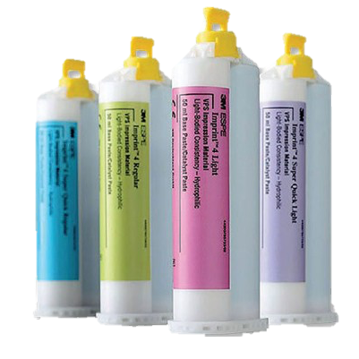
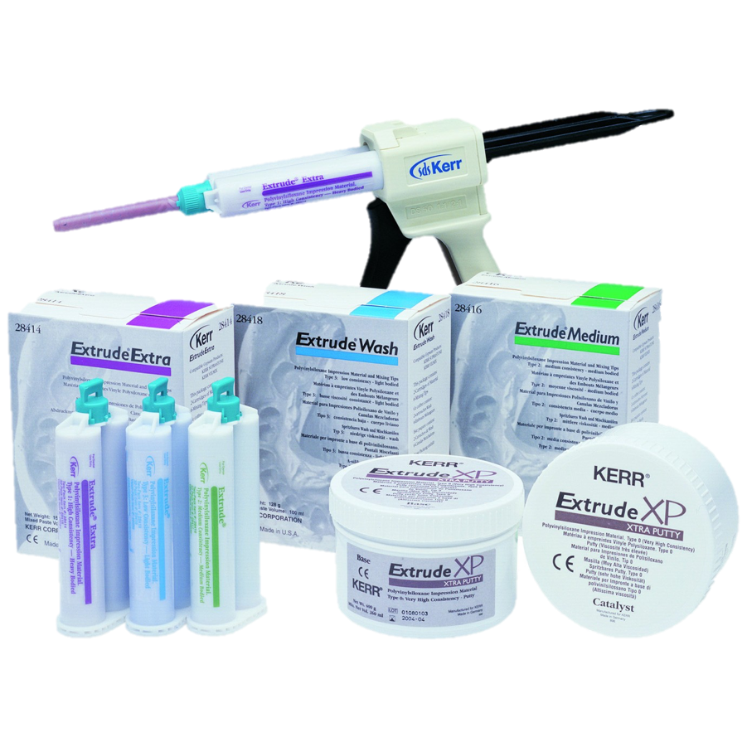
Edentulous Impression Material
Silicone
  Addition reaction
  Acceptable taste
  Dimensionally stable
  Elastic recovery

Slide 3
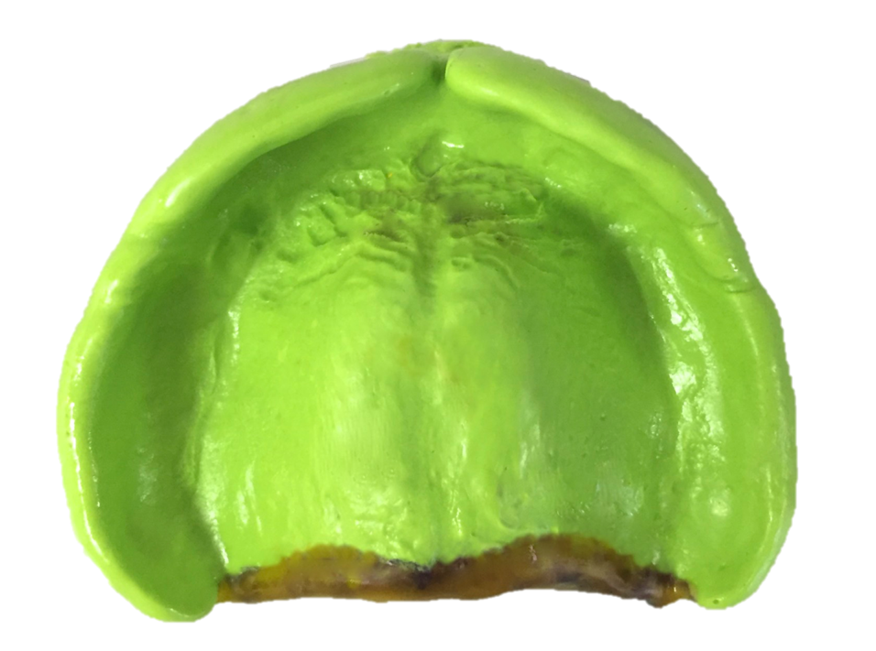
Polyvinyl Siloxanes (PVS)
Addition Reaction Silicone
Newer materials more hydrophilic
  Similar to Polysulfides & Polyethers
Flow
  Thixotropic
  Require pressure to flow

Slide 4
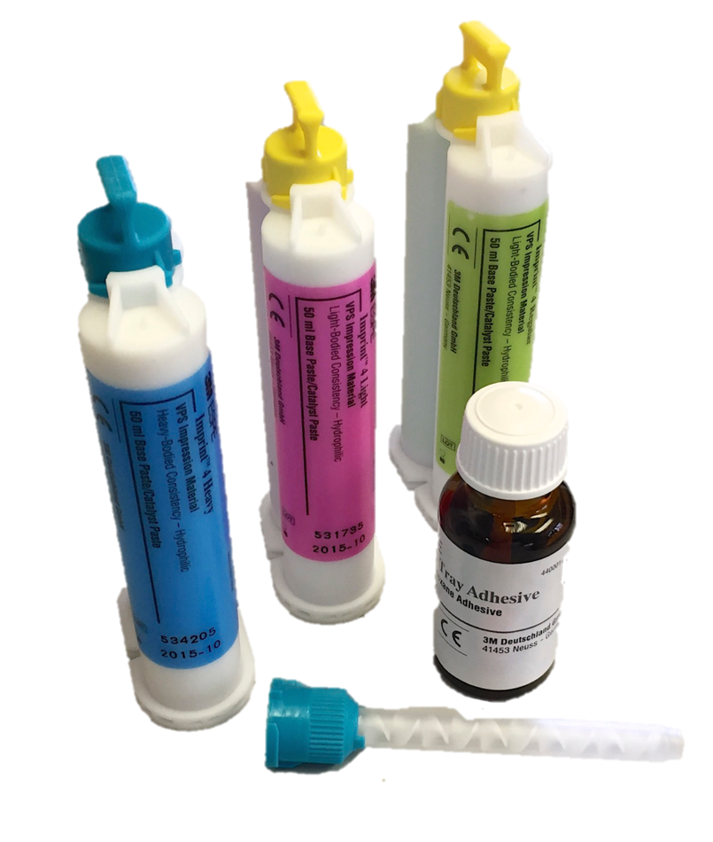
Polyvinyl Siloxanes
Addition Reaction Silicone
Good dimensional stability
Excellent elastic recovery
Excellent dimensional accuracy
Material of choice

Slide 5
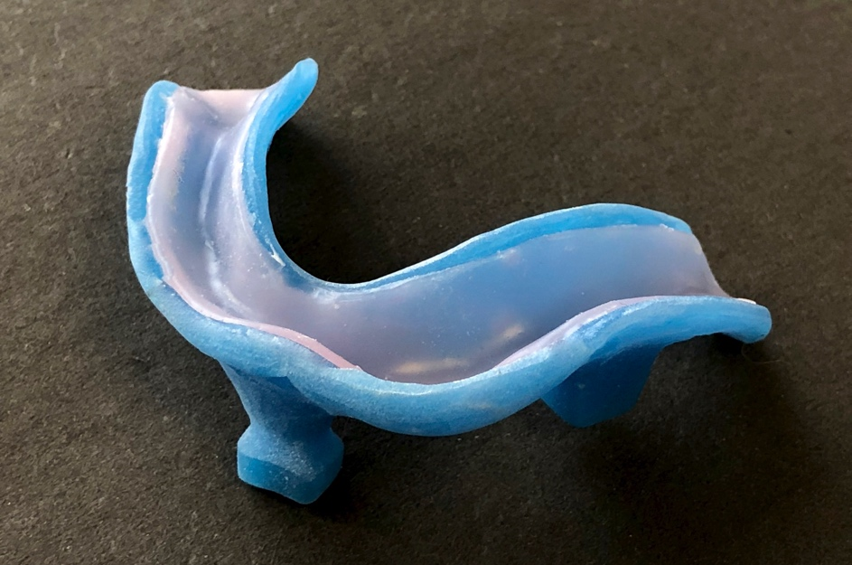
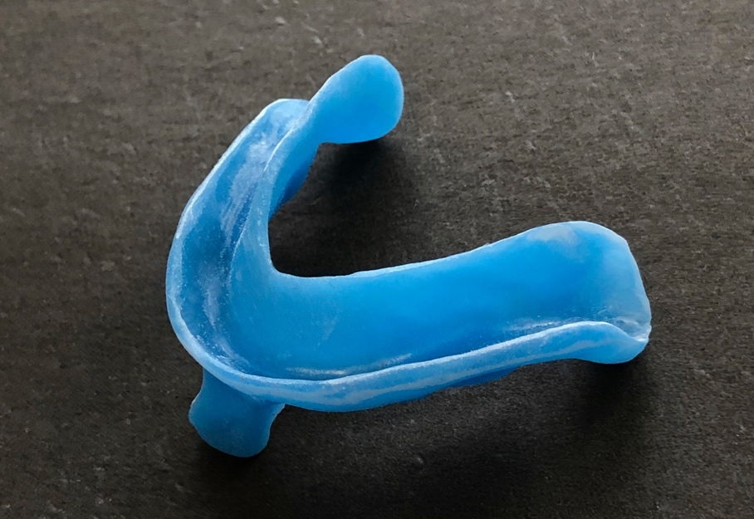
Tray Wax Spacer
Can be left in place or removed
Recommend removal prior to border molding:
  Less chance of overextensions
  Difficult to remove after border molding
  Spacer can melt during border molding

Slide 6
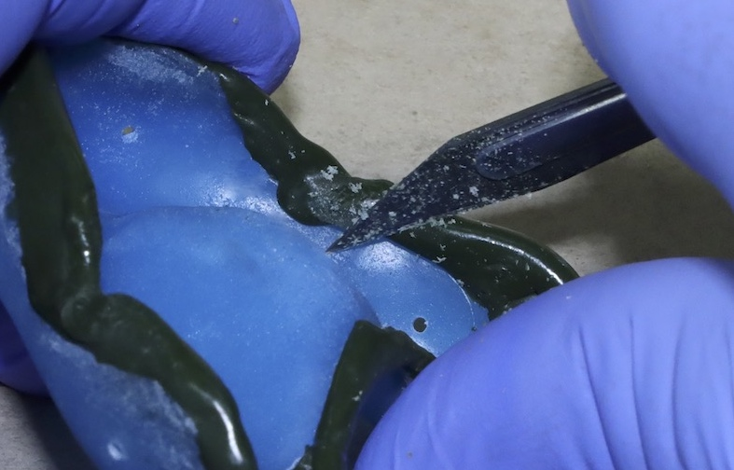
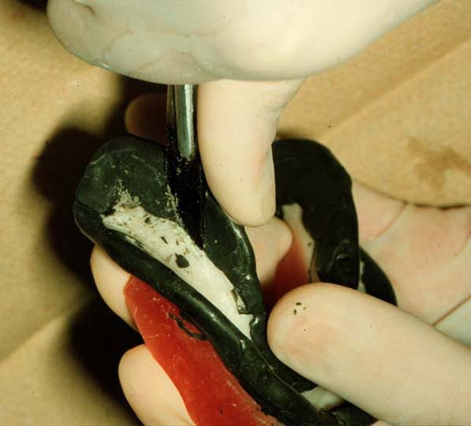
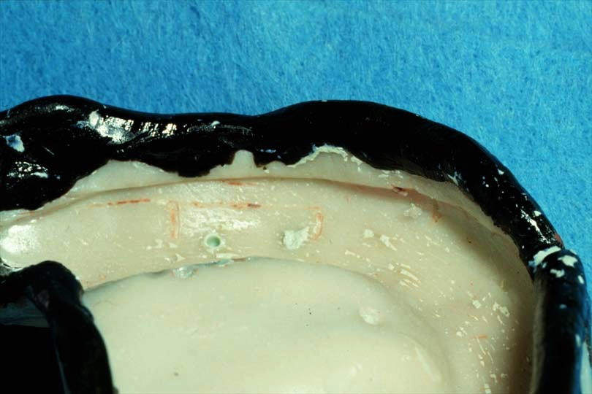
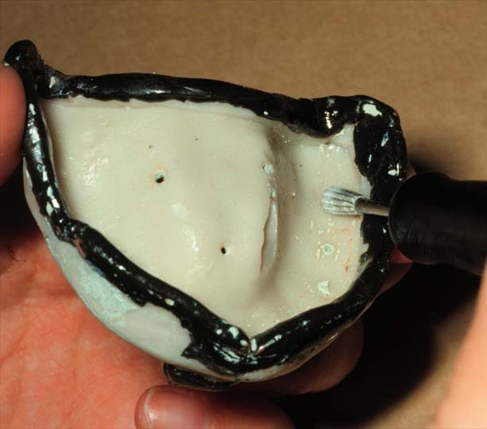
Custom Trays
Smooth sharp surfaces of border molding or tray

Slide 7
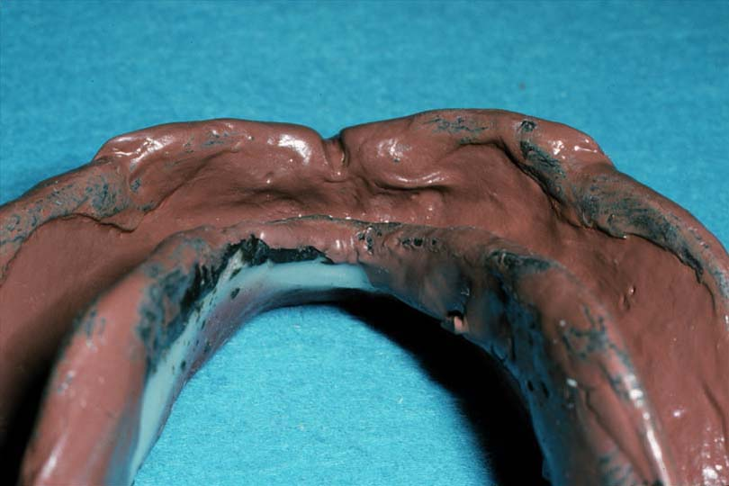
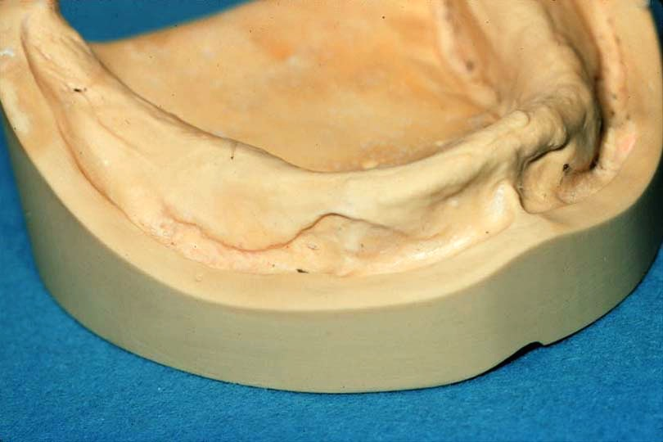
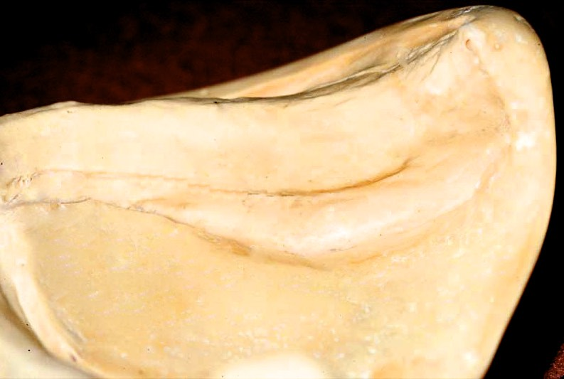
Effect of Sharp Borders

Slide 8
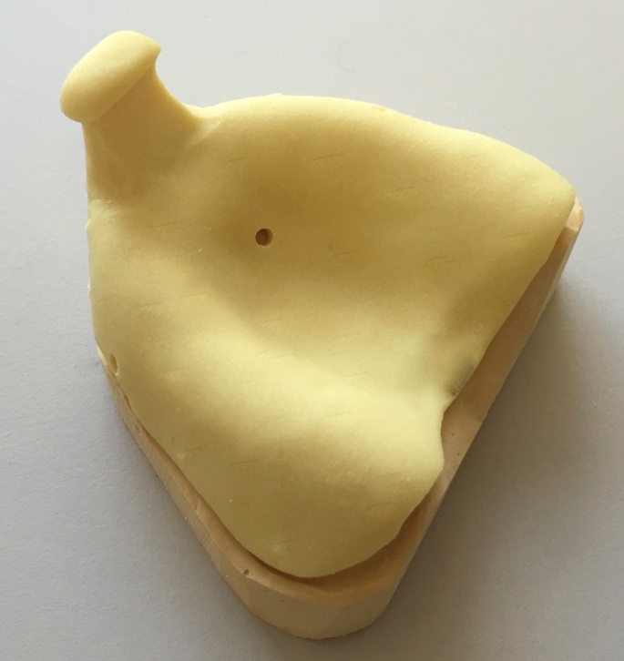


Custom Tray Perforations
After, NOT before border molding
Allows release of hydraulic pressure
More improves retention to tray, more relief from pressure
Too Many?
Too Few

Slide 9
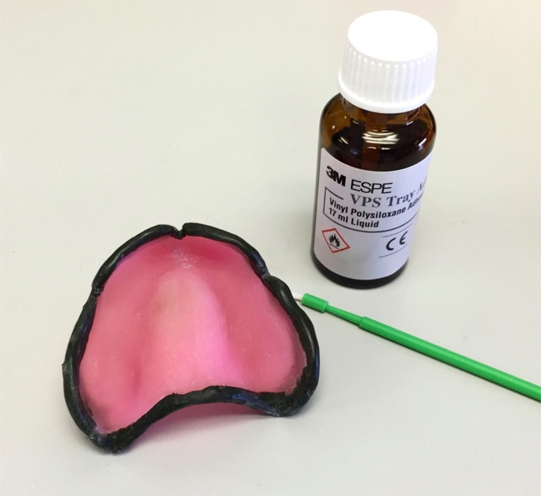
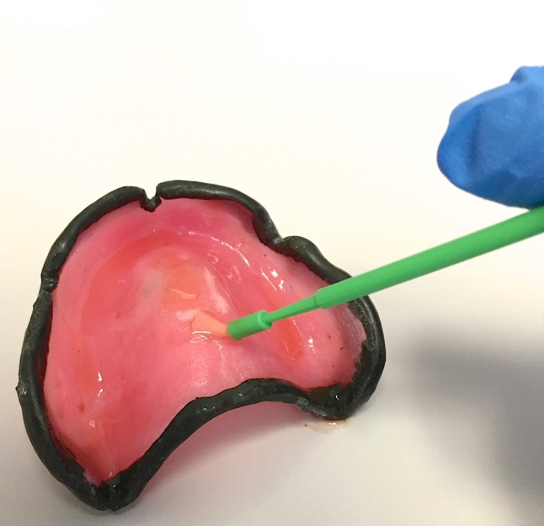
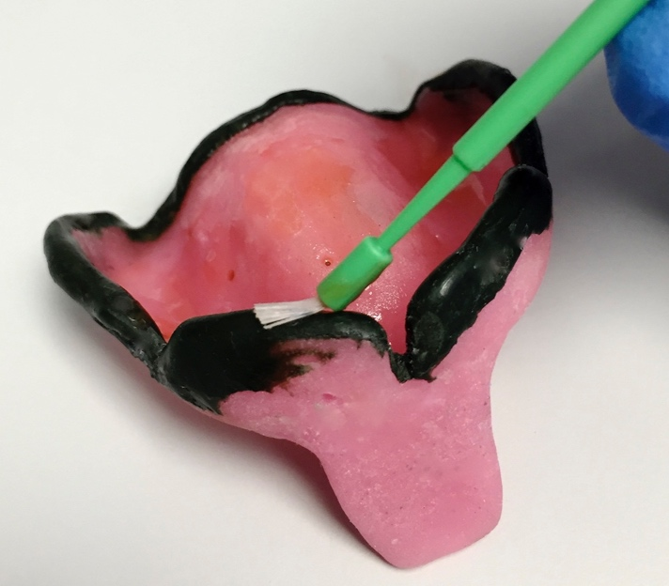
Adhesive
Paint inside of tray, after perforation
Thinner coat is better
Cover border molding

Slide 10
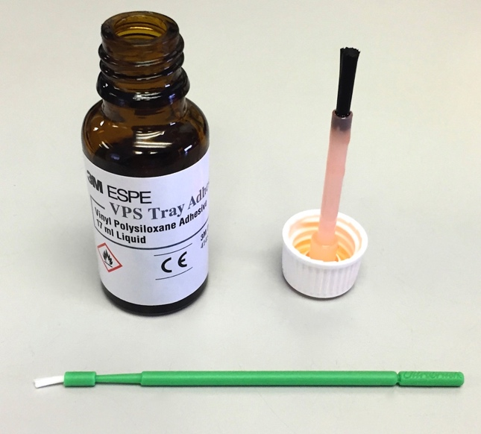
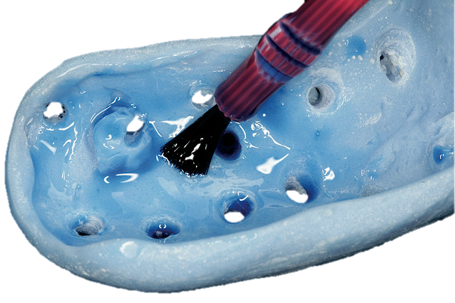
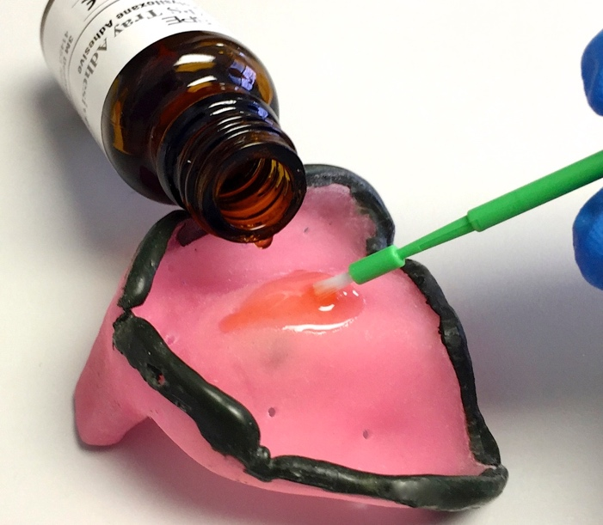
Adhesive
Pour small amount into tray
Spread THIN with disposable brush
Do NOT use cap brush
Allow to dry minimum of 5 minutes
X
Too thick
Just Right

Slide 11
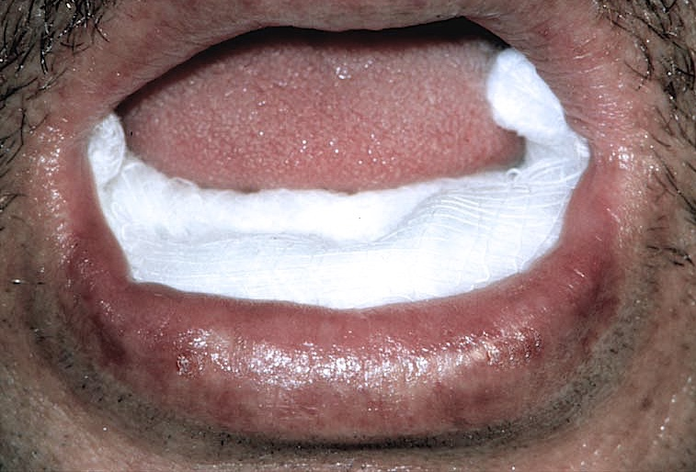
Final Impressions
Dry tissues with 2x2 gauze folded in cotton pliers

Slide 12
Tissue Rest
Leave dentures out 24 hours
  Tissue recovery
Use low viscosity polyvinyl siloxane material
  Use adhesive

Slide 13
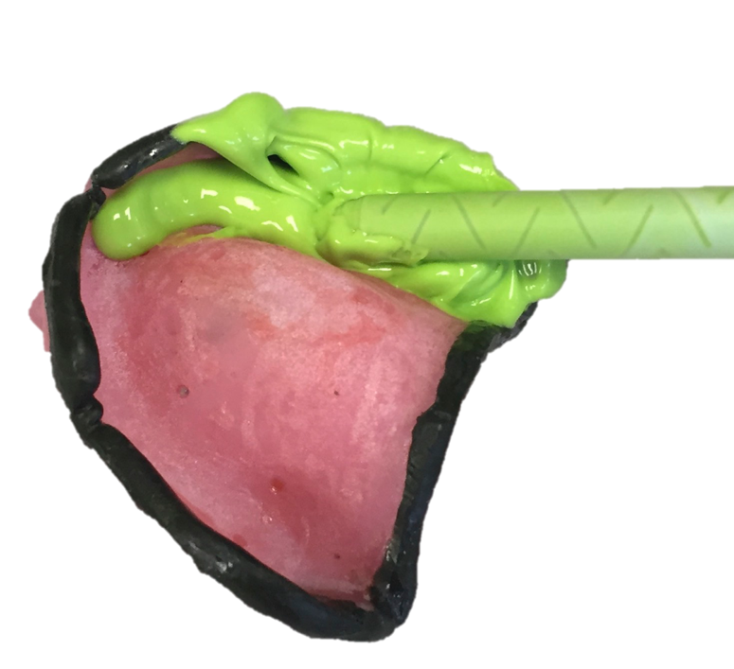
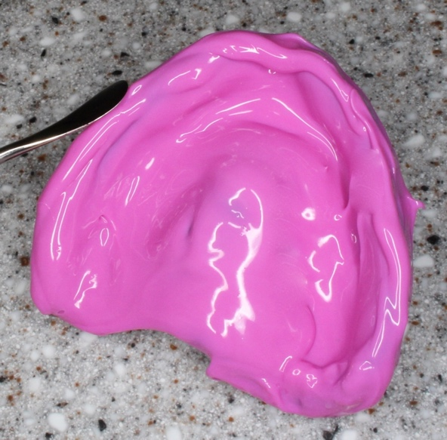
Loading Custom Trays
Enough material to replace wax spacer
Load quickly – viscosity increases rapidly
Avoid bubbles when loading
Bring material over peripheries

Slide 14
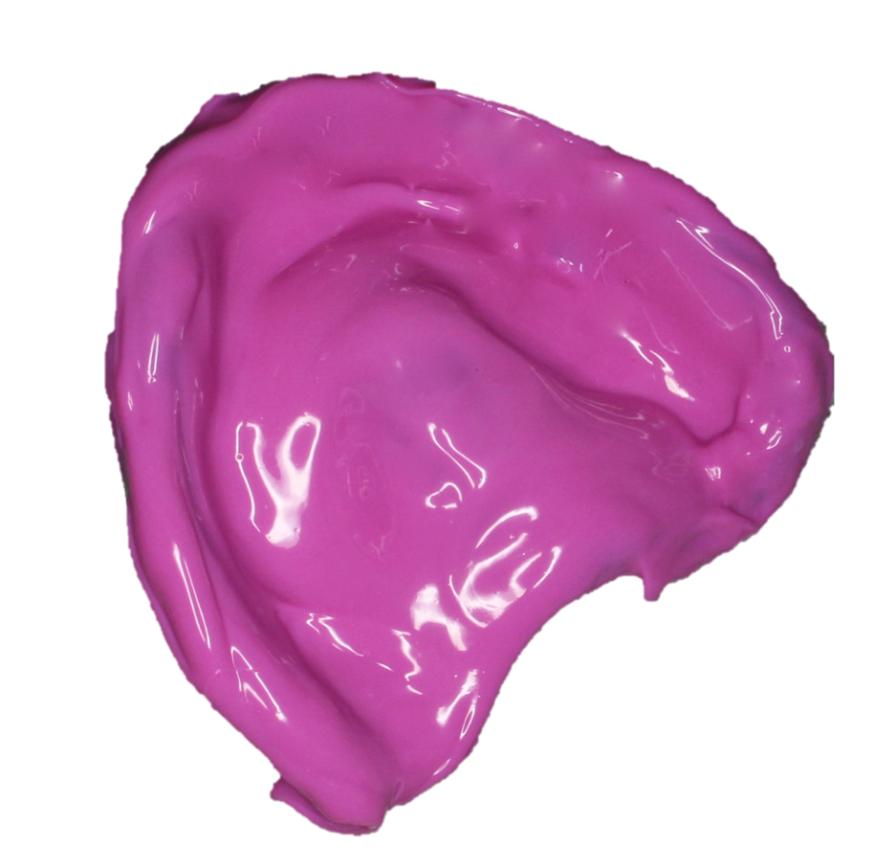
Cover Peripheries
Cover border molding
Minimizes chance of voids in vestibule

Slide 15
Tray Insertion
Insert side of tray against commissure of mouth & rotating tray into place while pulling outward on commissure of contralateral side

Slide 16
Final Impressions
Seat tray front to back - use gauze over holes in tray
Ensure tray is centered & properly oriented
Subsurface Voids
Tech. Dentist
A B C TOTAL
F-B 3 2 1 6
Even 4 3 6 13
B-F 6 4 3 13
__________________________
TOTAL 13 9 10 32

Slide 17
Tissue Manipulation
Maxilla
Slight manipulation of cheeks, lips
Patient moves mandible to side to side for maxillary impression

Slide 18
Tissue Manipulation
Mandible
Hold tray in position & have patient:
  Pucker lips
  Lift & move tongue forward & side to side

Slide 19
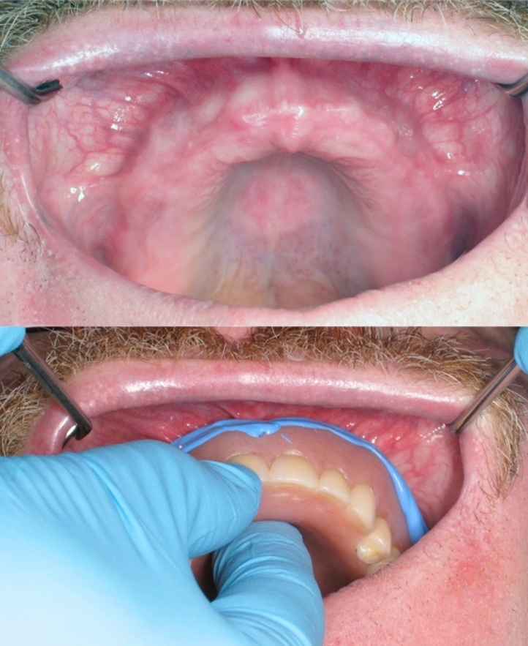
Final Impression Video
Final Impression
Two Mirror Technique

Slide 20
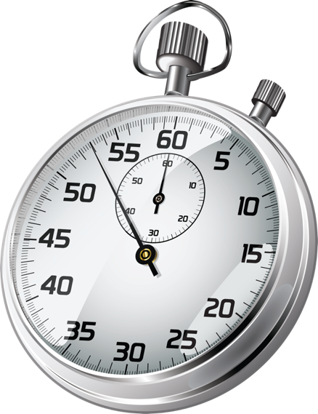
Set Time
Most PVS materials set within 6 min
Know the set time
Don’t remove prematurely (distortion)

Slide 21
Evaluating Impressions Video

Slide 22
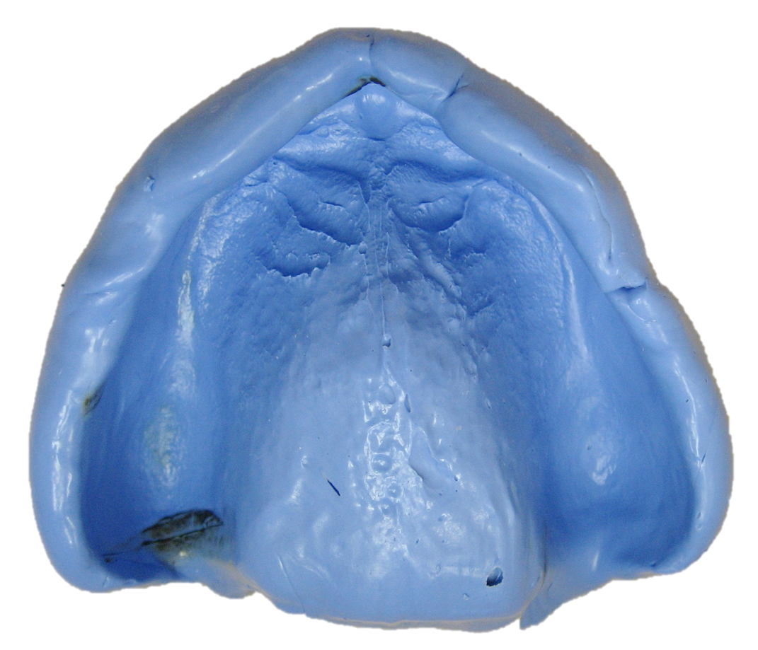
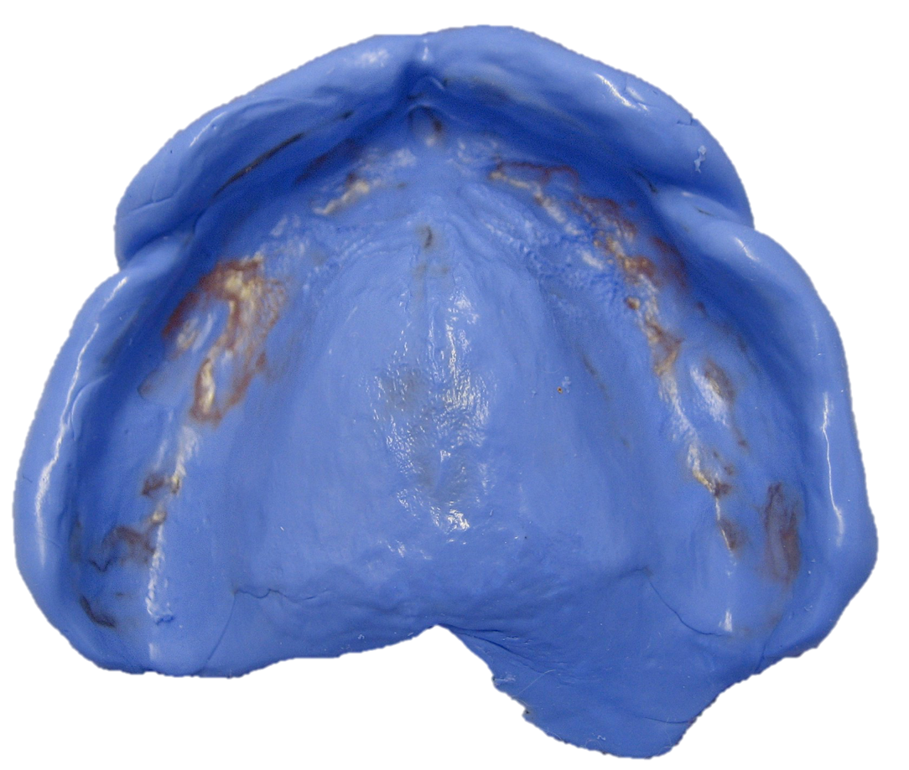
Maxillary Final Impressions
Thick Peripheries, Burnthrough (Tuberosity),
Folds & Seams on Peripheries
Excessive Burnthrough
Thick Anterior Periphery

Slide 23
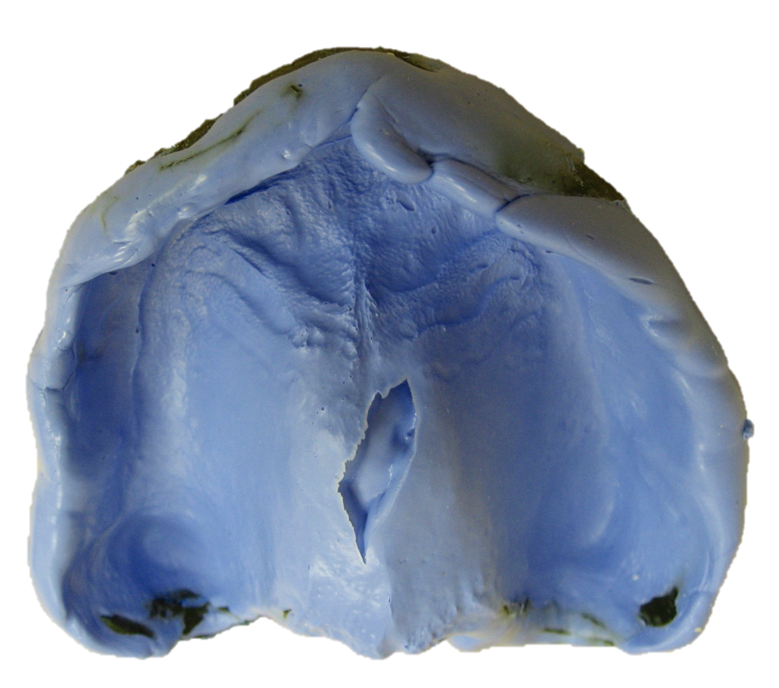
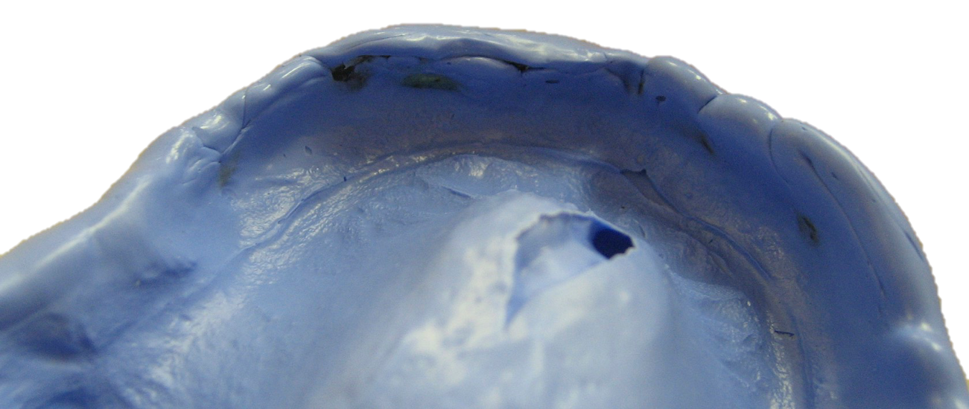
Maxillary Final Impressions
Large Palatal Void, Burnthrough (Tuberosity),
Folds & Seams on Peripheries

Slide 24
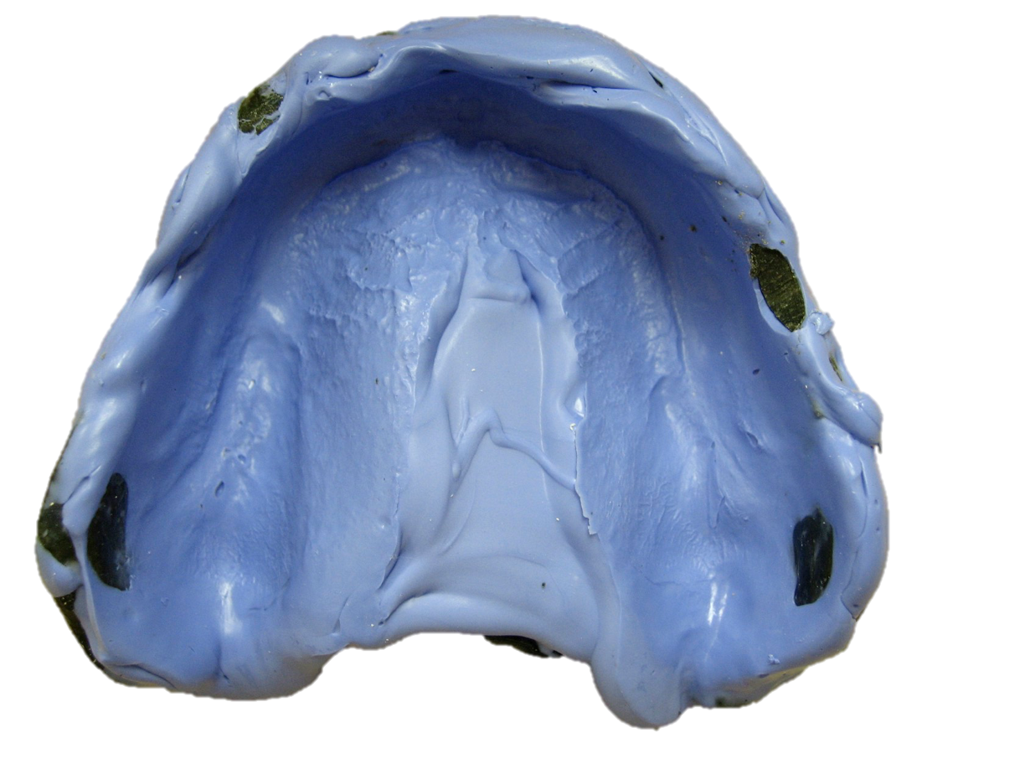
Maxillary Final Impressions
Immense Palatal Void,
Burnthrough (Tuberosities),
Folds, Seams, Incomplete Peripheries

Slide 25
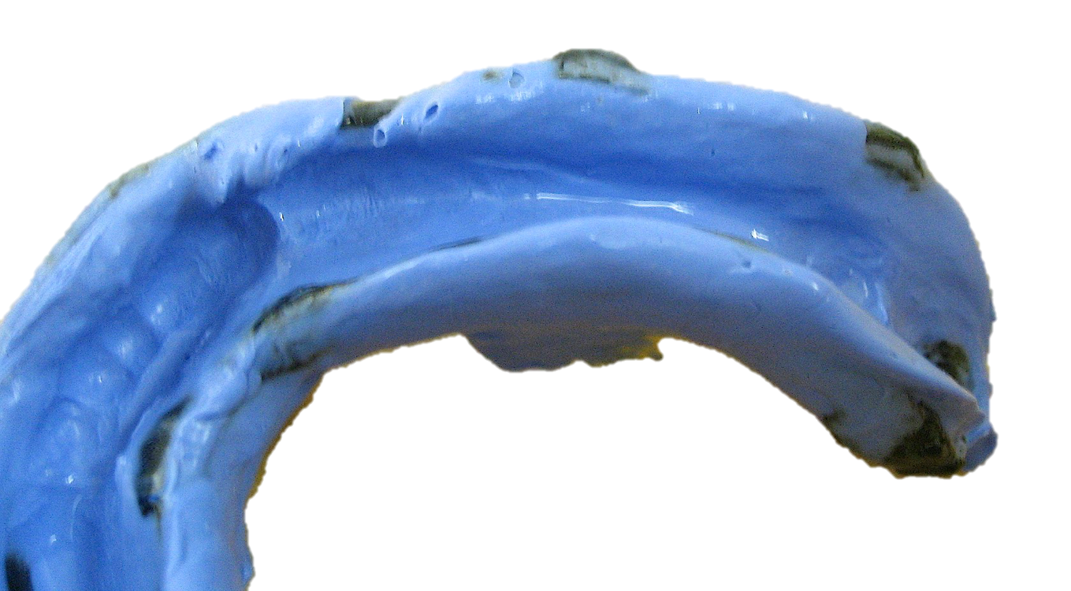
Significant Burnthrough
Distorts Tissue Contours
Significant Burnthrough
Significant Burnthrough

Slide 26
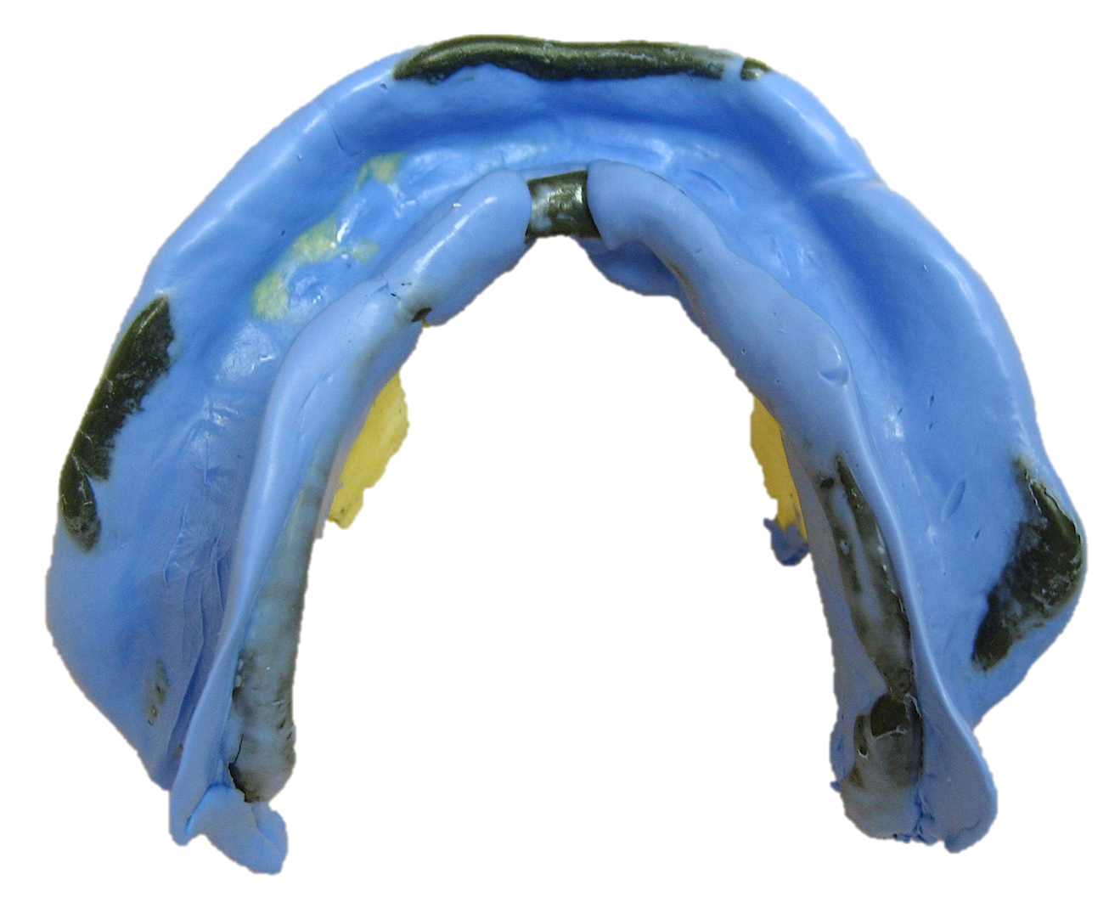
Mandibular Final Impressions
Significant Burnthrough
Significant Burnthrough
Significant Burnthrough
Thin Undercut Peripheries

Slide 27
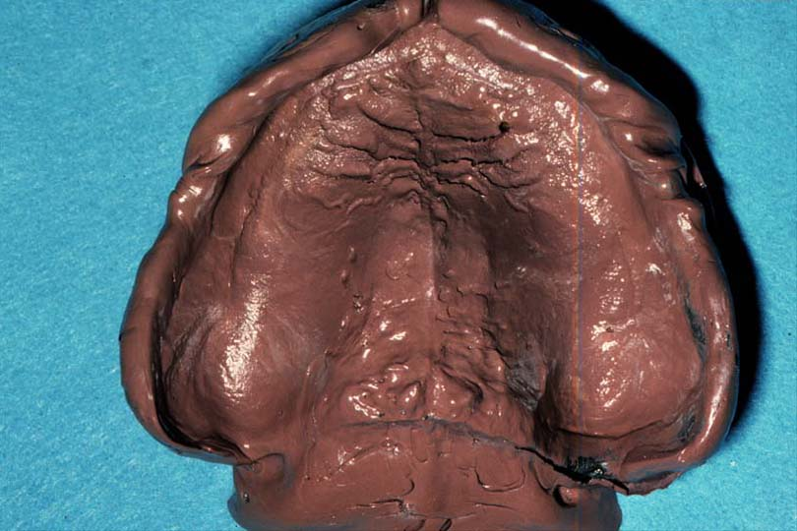
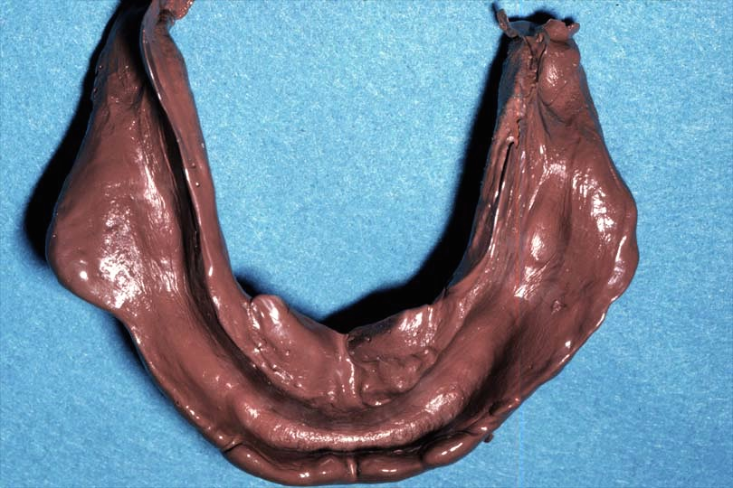
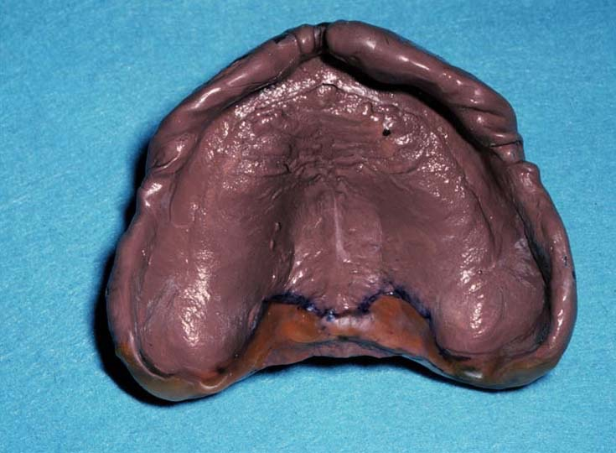
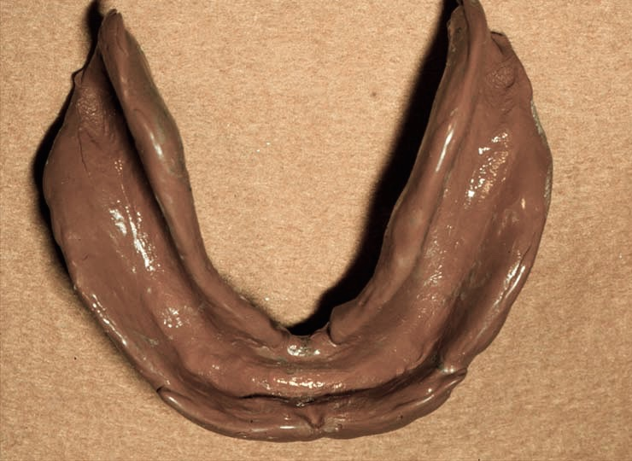
Trim Impressions

Slide 28
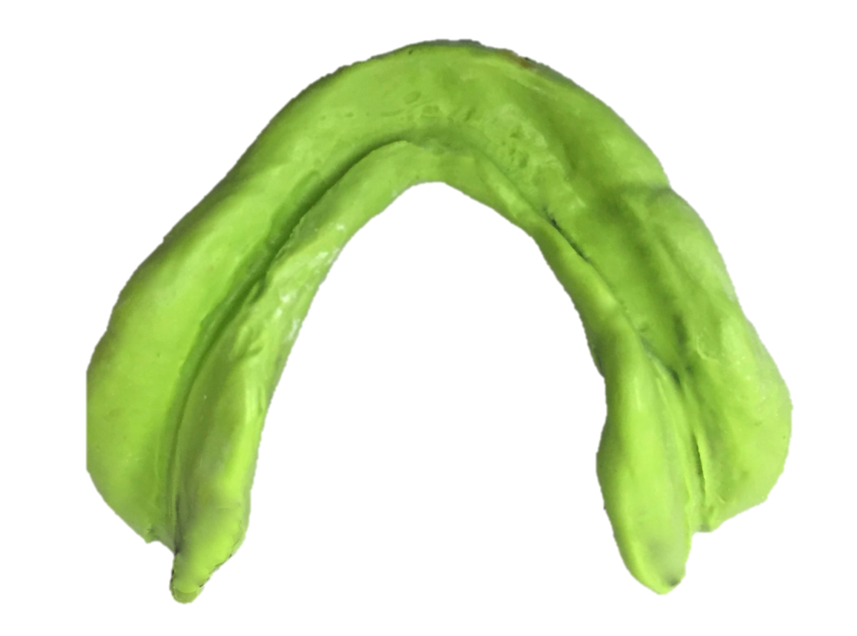
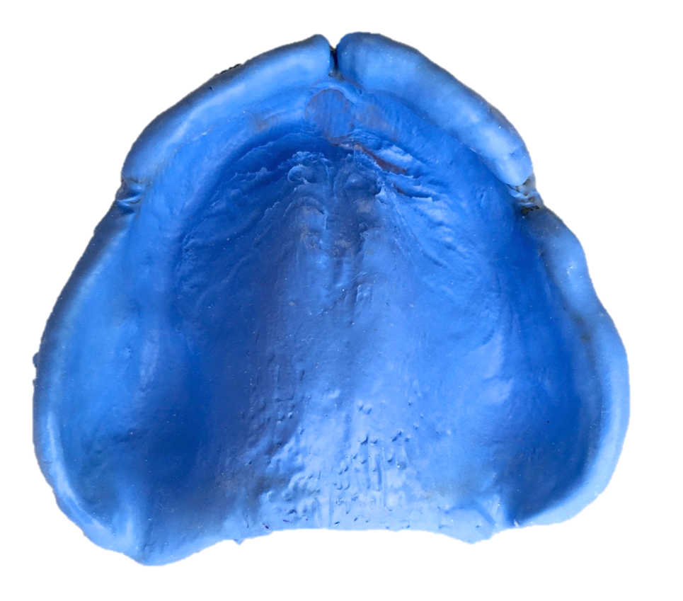
Acceptable Final Impressions

Slide 29
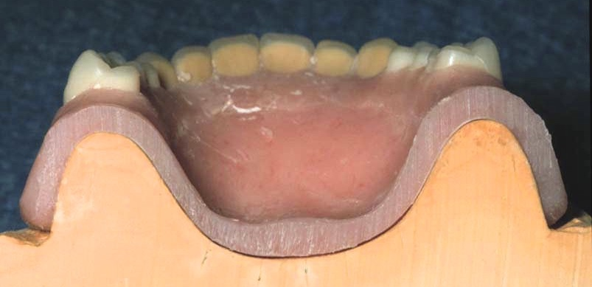
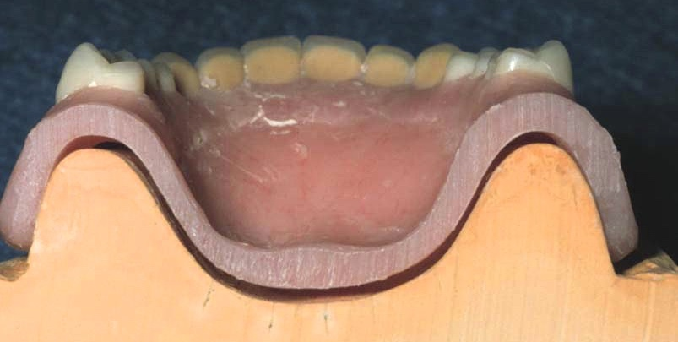
Post-palatal Seal
(Post Dam)
Compensates for polymerization shrinkage and distortion from palate
Enhances retention
Prior to Removal from Cast
After Removal from Cast

Slide 30
Post Dam - displaces tissue to create seal
Movable Soft Palate
Posterior of Denture – vibrating line
From Dr. J Shotwell, U of Michigan

Slide 31
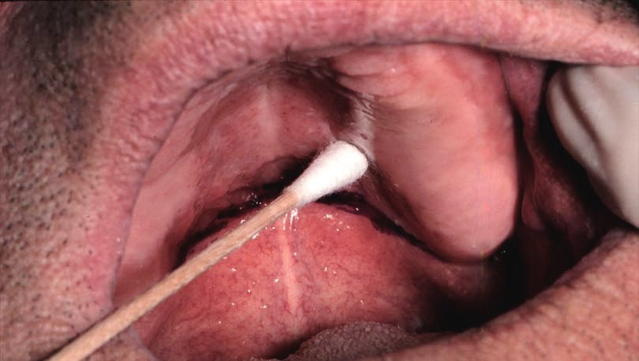
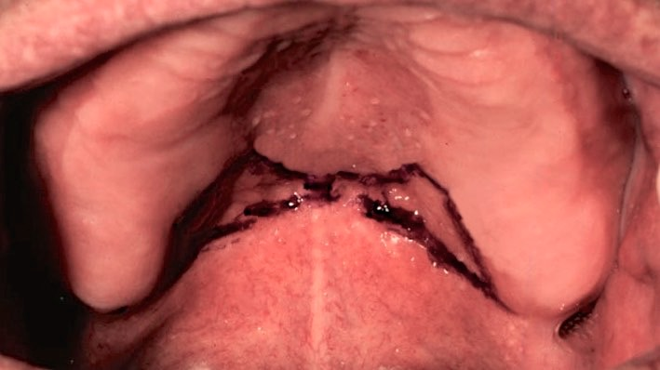
Post-palatal Seal
Mark post-palatal seal with indelible stick – glandular area & vibrating line
Place impression in mouth, line transfers to impression

Slide 32
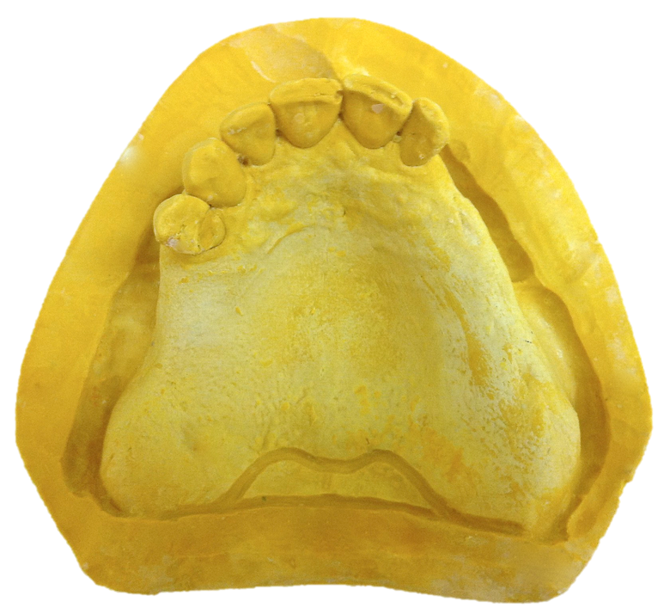
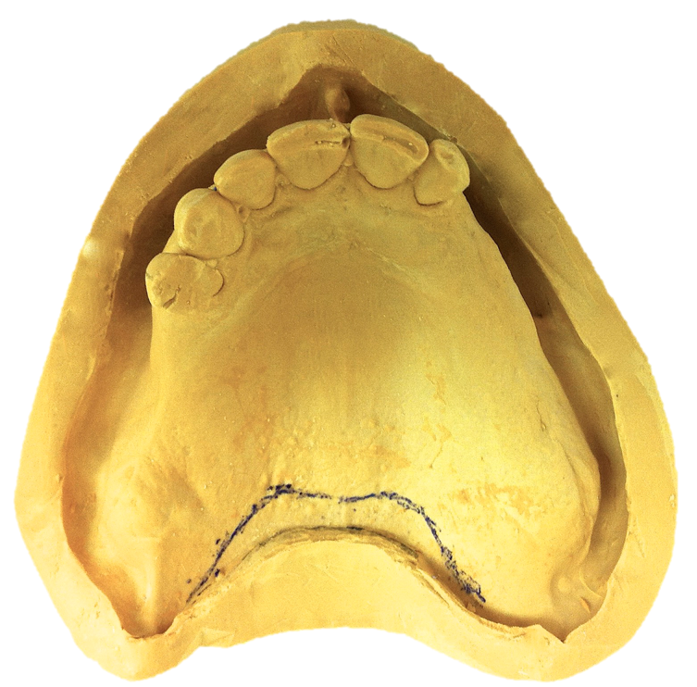
Post-palatal Seal
If short of vibrating line and hamular notches
Lack of retension

Slide 33
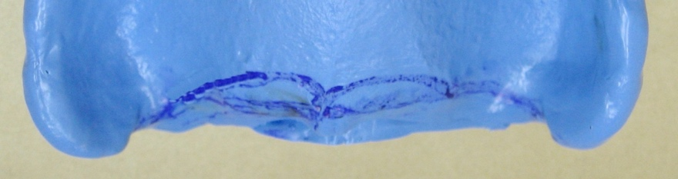
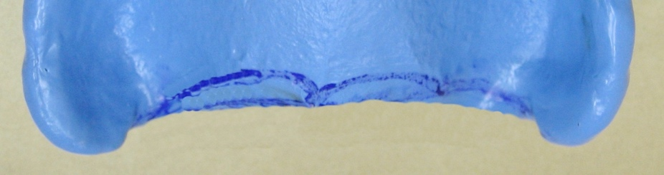
Post-palatal Seal
Disinfect, dry
Refresh the line with new indelible stick
Trim to vibrating line and hamular notches with scissors and/or scalpel

Slide 34
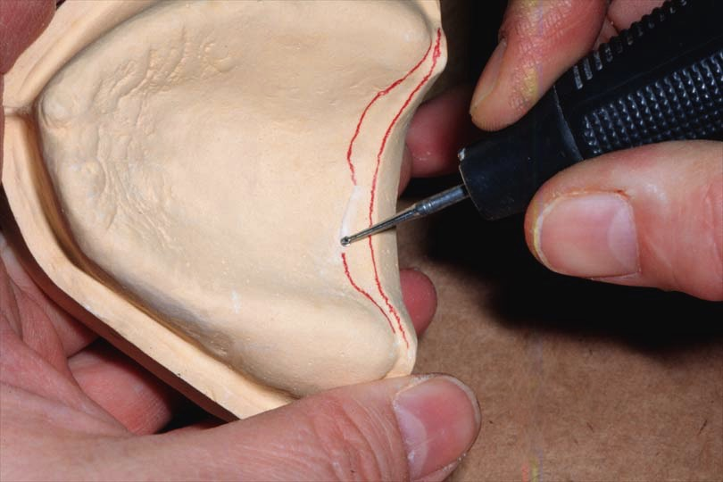
Post-palatal Seal
Prescribe a mechanical post-palatal seal
Pour impression in Type III stone (ie. Microstone)
Mark location, Laboratory will perform

Slide 35
Boxing Final Impressions
Rationale
Superior hardness of cast surface
Provides land area & preserves peripheral role
Minimizes trimming

Slide 36

Boxing & Pour Impression Video

Slide 37


Trimming the Cast
Soak in Slurry
Trim – Keep Damp

Slide 38


Trimming the Cast
Land Area = 3-6mm Wide
Land Area Too Wide to fit Flask
3-6mm Land Area

