Slide 1
Anatomy for Complete & Partial Dentures

Slide 2
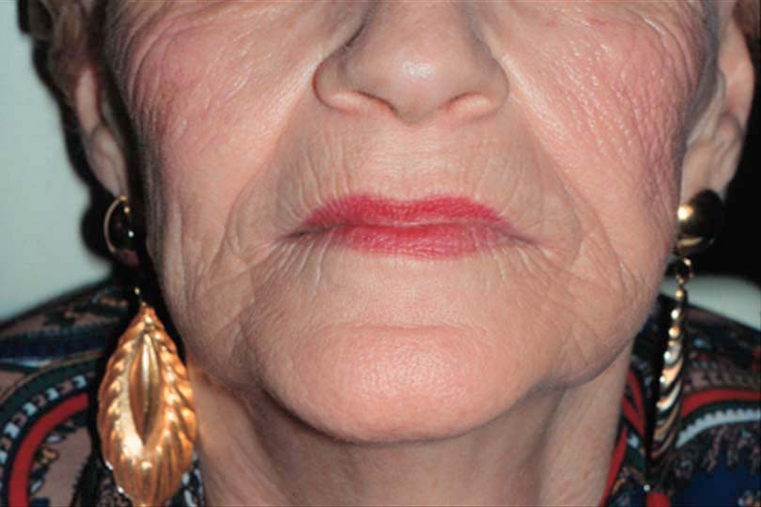
Lips
Vermilion Border
  Denture provides lip support
    Affects vermilion border width

Slide 3
Philtrum of the Lip
Depression below nose
If excessive support from denture, philtrum is lost, looks unnatural

Slide 4
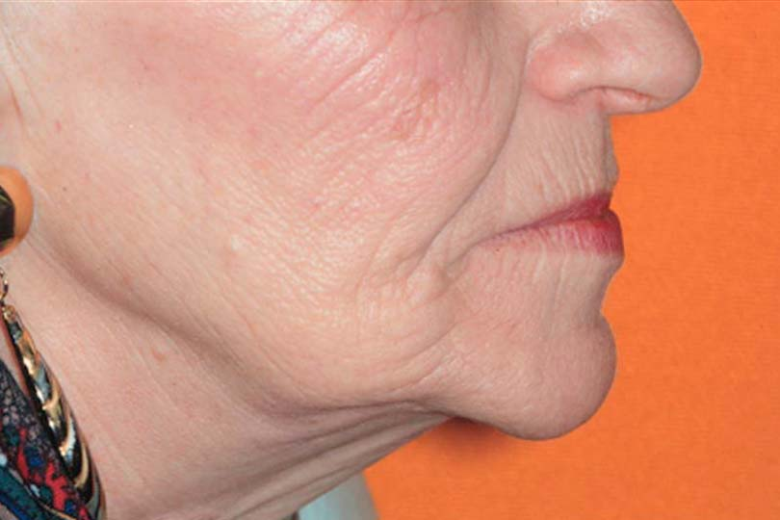
Nasolabial Angle
Angle between columella of nose & philtrum of lip
Normally, approximately 90 as viewed in profile

Slide 5
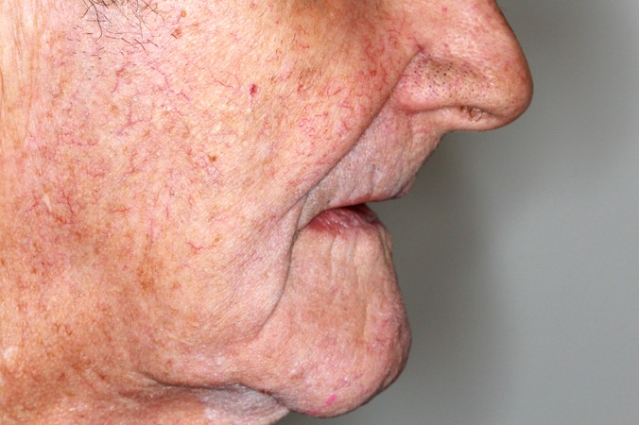
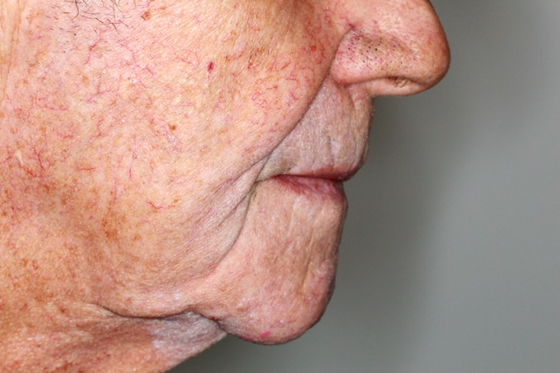
Lips
Nasolabial Angle
Affected by the support from replacement teeth

Slide 6
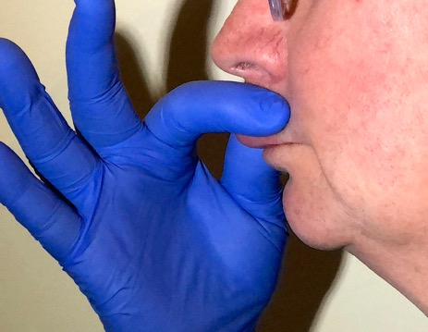
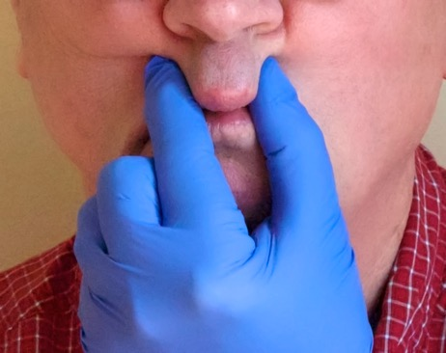
Tissue of the Upper Lip
  Loose tissue of upper lip can be gathered between thumb & index finger
    If excessive support, no loose tissue, tight appearance
    If inadequate support, lots of loose tissue, loss of visible vermillion border

Slide 7
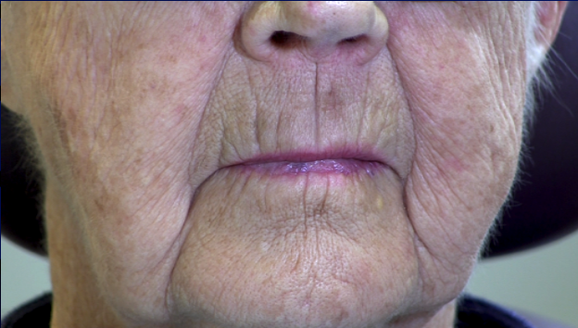
Tissue of the Upper Lip

Slide 8
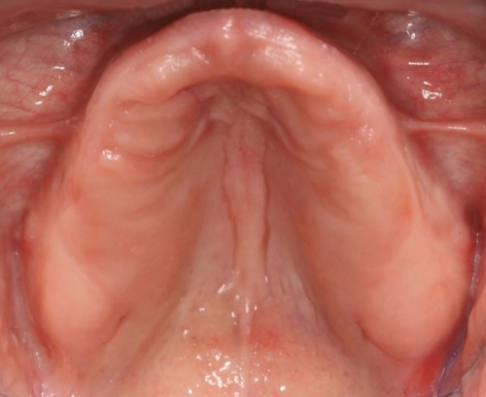
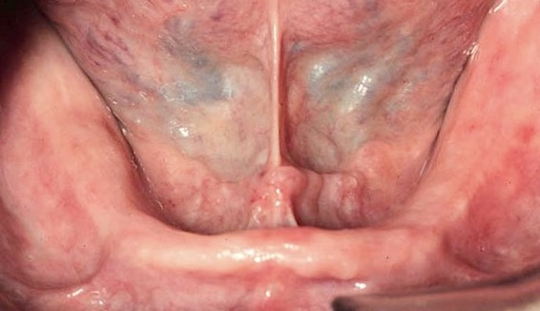
Residual Ridges
Rounded ridges with good height, parallel sides and minimal undercuts are best
  Improves retention & stability
  Minimal impingement during seating

Slide 9
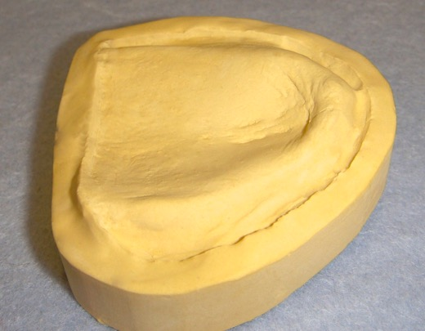
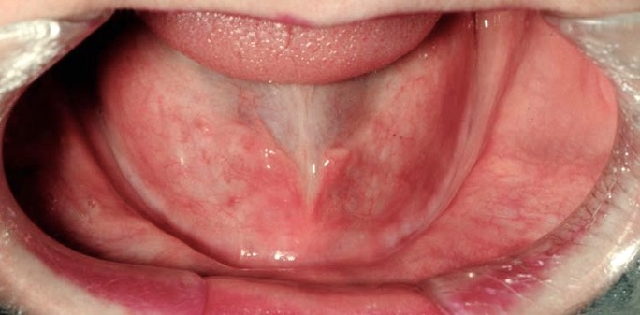
Resorbed Residual Ridges
If severely resorbed, inform patient
  Significantly reduces retention & stability

Slide 10
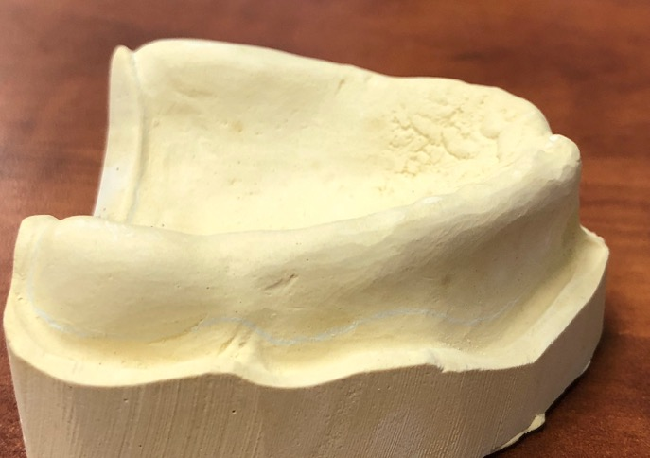
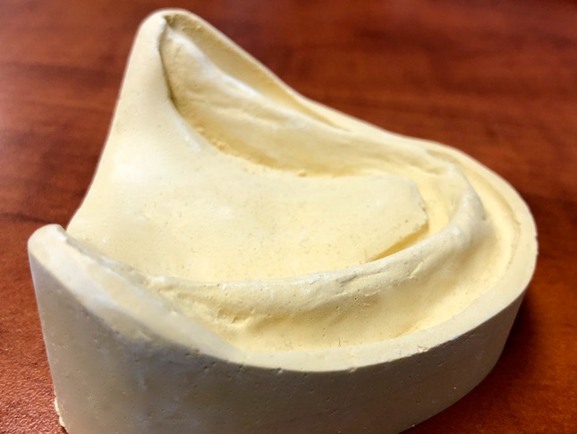
Residual Ridge Shape
V-shaped ridge offers little resistance to horizontal displacement
Horizontal force resisted by vertical surface
Horizontal force causes slide & displacement along inclined surfaces

Slide 11
Undercut Residual Ridges
If undercut (top of ridge wider than vestibular portion):
  Denture may pinch/ulcerate mucosa as seated
  Denture may not seat at all if large undercut
Ridge
Denture Base

Slide 12
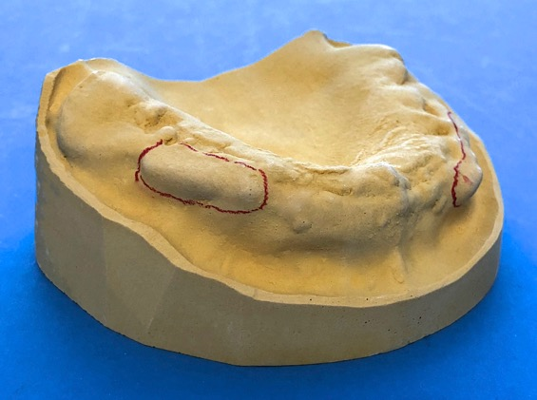
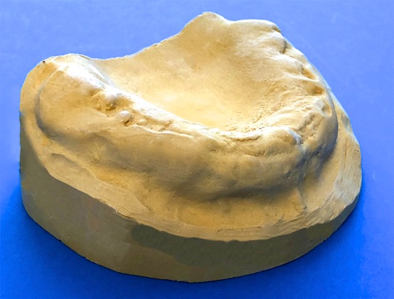
Undercut Residual Ridges
Large undercuts may
  require surgical reduction
  Prevent placement of the denture
  Cause discomfort if related to bony projections (impingement)
Bony projections and undercuts will make seating and comfort difficult
Surgical reduction provides more rounded profile with reduced undercuts for comfort

Slide 13
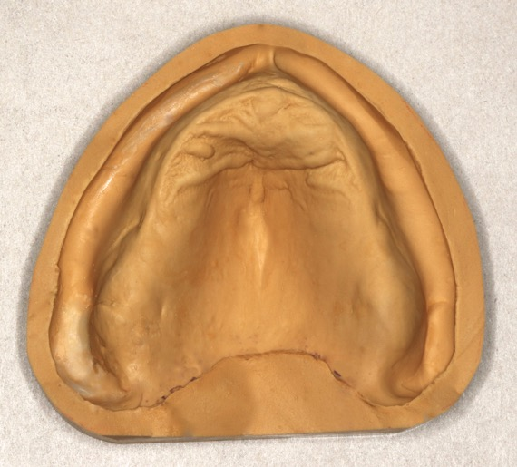
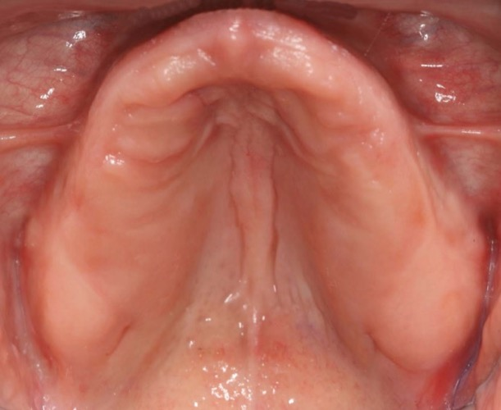
Maxillary Tuberosities
  Most posterior portion of maxillary ridge
  Best when normal size, not undercut, firm mucosa over residual ridge

Slide 14
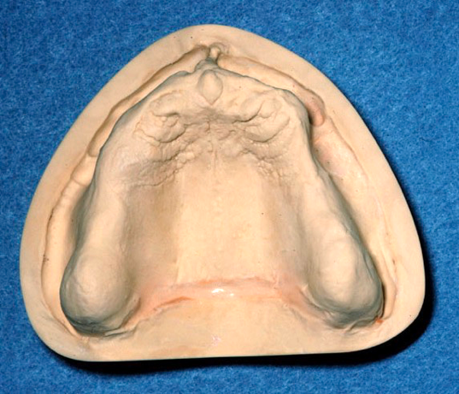
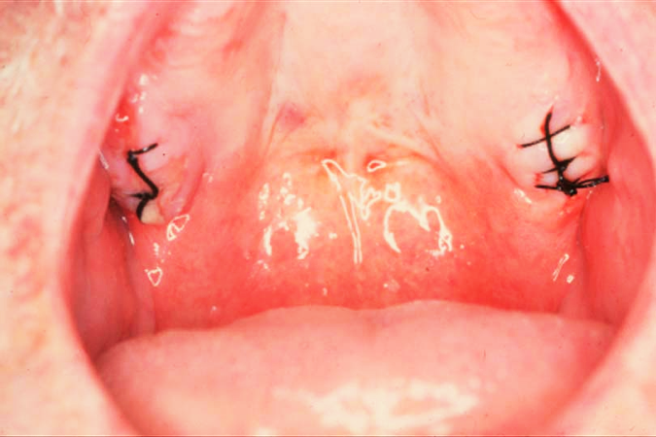
Maxillary Tuberosities
Maxillary Tuberosities
  If flabbly, fibrous or moveable, reduces stability
  May require surgical reduction

Slide 15
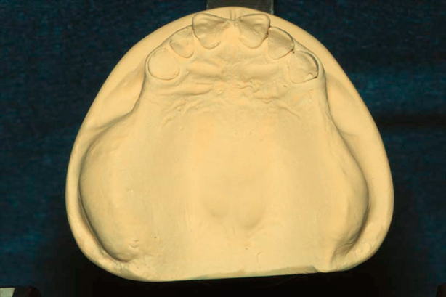
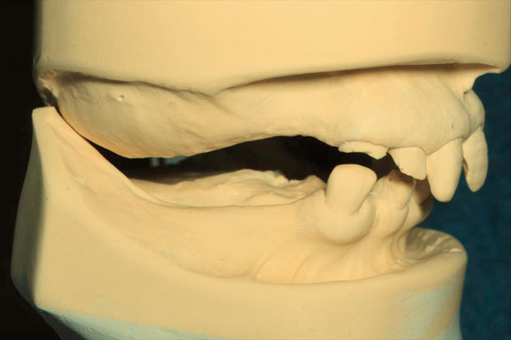
Maxillary Tuberosities
If oversized may require bony surgical reduction to provide room for denture bases
Undercuts can impeded seating and may need surgical reduction
No space for maxillary & mandibular denture bases

Slide 16
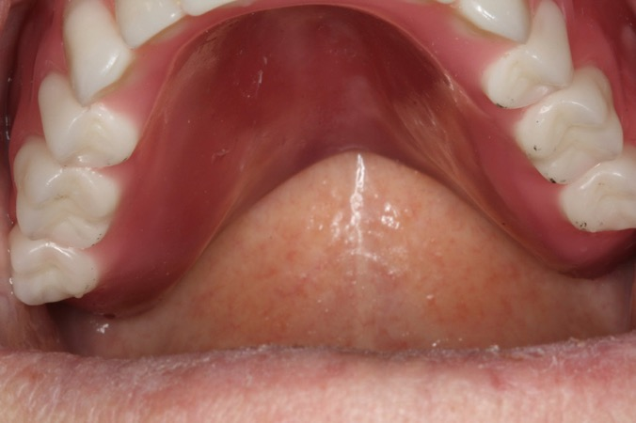
Termination of Posterior Border of Maxillary Denture
Hamular Notch
Vibrating Line
Critical to terminate on these areas of soft displaceable tissue
  Retention
  Comfort
2
1

Slide 17
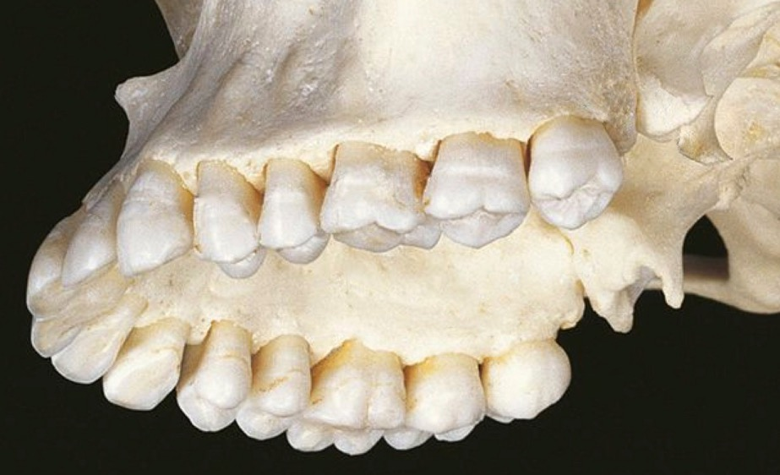
Hamular Notch
Posterior border denture
  Between the bony tuberosity and hamulus
Hamulus
Notch
Tuberosity

Slide 18
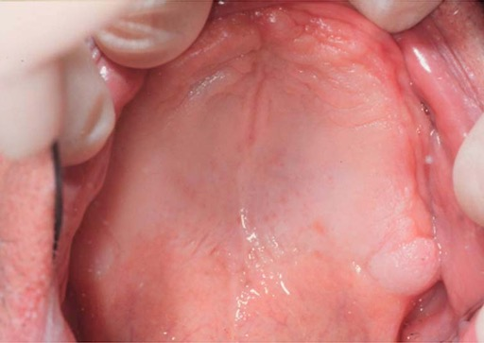
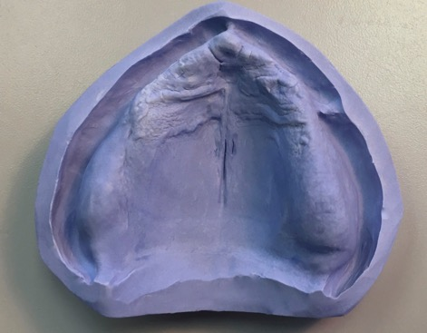
Hamular Notch
Not always located at soft tissue depression
Use head of mirror to palpate notch & mark with indelible marker
If terminate on tuberosity by mistake, lack of seal, loose denture

Slide 19
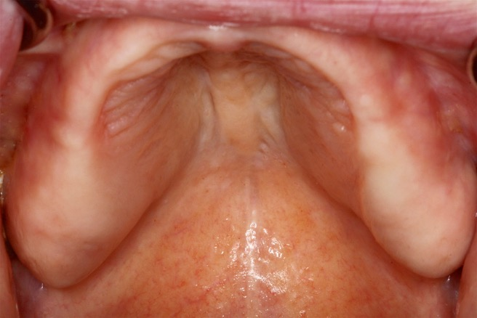
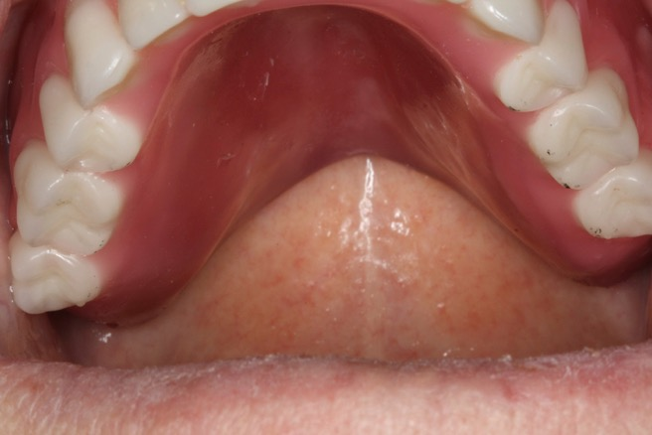
Vibrating Line
Junction of movable & immovable portions of the SOFT palate
If terminate denture on hard palate – poor seal
If terminate on moveable soft palate, dislodged as soft palate moves

Slide 20
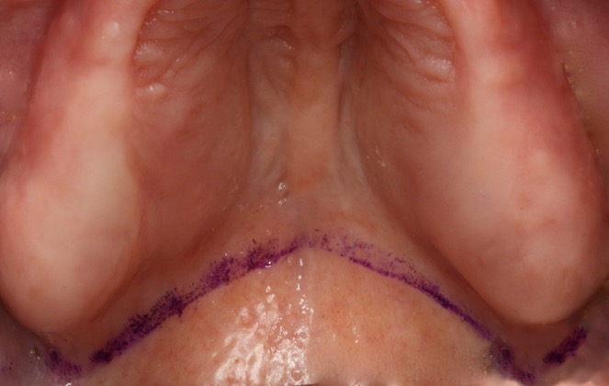
Identifying the Vibrating Line
Palpate just posterior to hard palate
Place indelible mark
Have patient say ‘ah’ once
Mark should not move – if does, move anteriorly and mark again

Slide 21

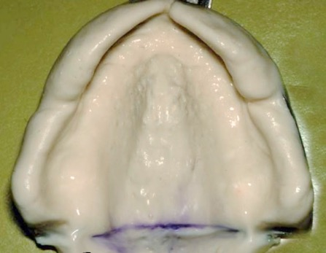
Identifying the Vibrating Line
Palpate just posterior to hard palate
Place indelible mark
Have patient say ‘ah’ once
Line should not move – if does, move anteriorly and mark again

Slide 22
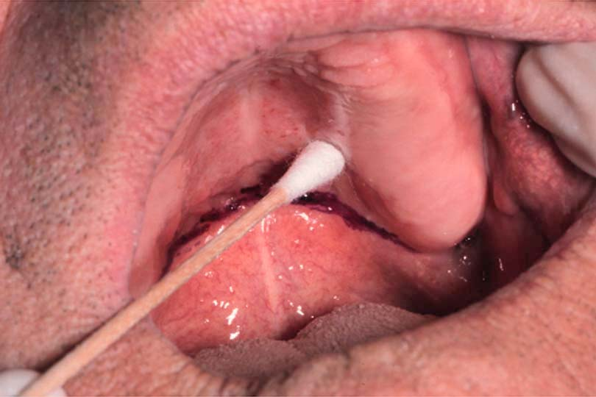
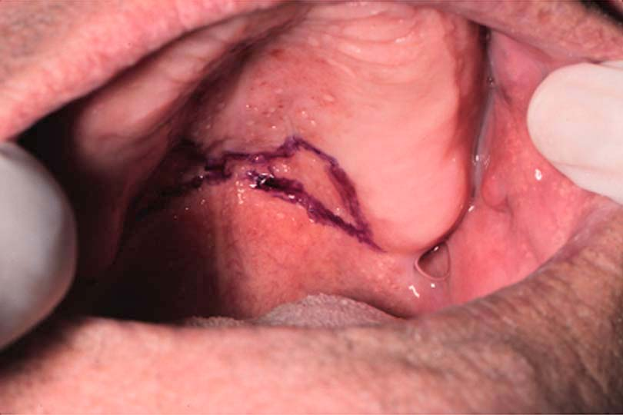
Maxilla
Glandular Tissue
  Soft displaceable

Slide 23
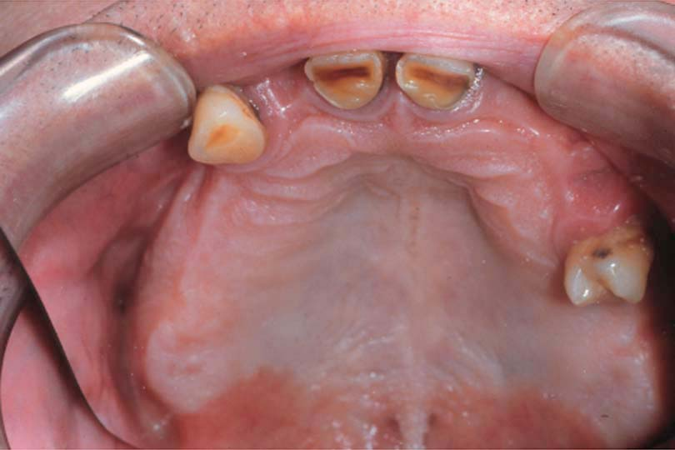
Maxilla
Soft Palate
  Fovea Palatine
    Bilateral indentations near midline of the soft palate
    Close to the vibrating line

Slide 24

Maxilla
Hard Palate
  1°stress bearing area for denture on either side of median palatine raphe

Slide 25
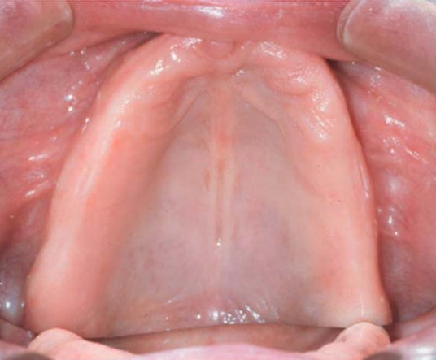

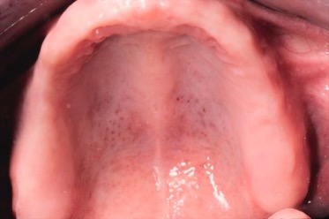
Maxilla
Hard Palate
  Median Palatine Raphe (midline palatine suture)
    A bony midline structure
    May require relief to prevent discomfort & pressure that can cause denture fracture if significantly raised

Slide 26
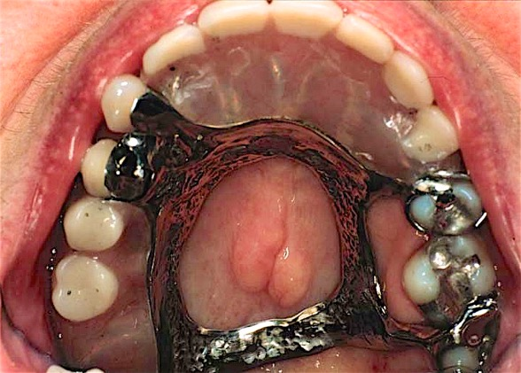
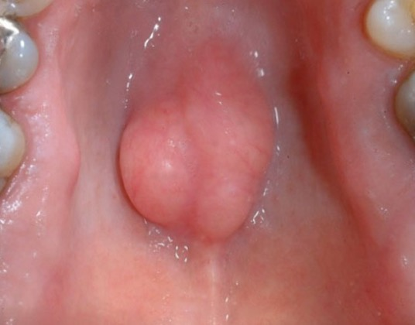
Maxilla
Torus Palatinus
  May require removal

Slide 27
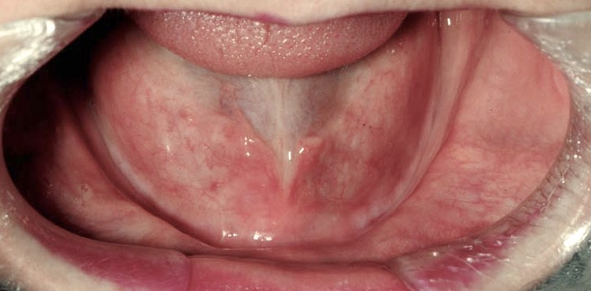
Vestibules
If vestibules are shallow, inform the patient (expect decreased retention
Buccal + lingual in mandible

Slide 28
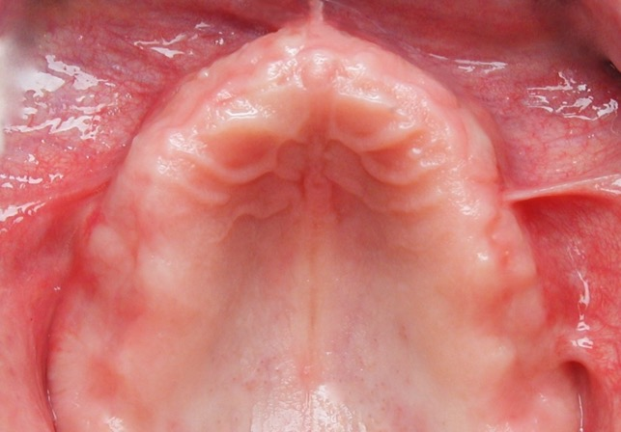

Maxillary Frena
(singular = frenum)
Labial and Buccal
  Must provide relief, otherwise:
    Displacement
    Discomfort
    Ulceration
  Identify prominence prior to impressions
Labial
Labial
Buccal
Buccal

Slide 29
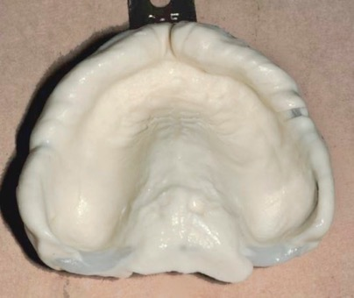
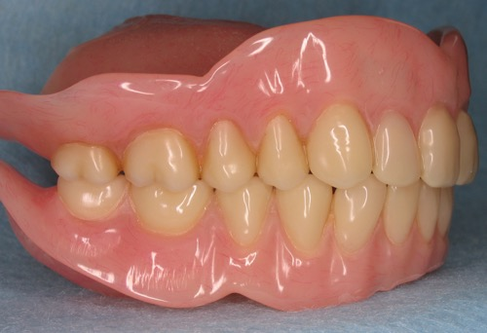
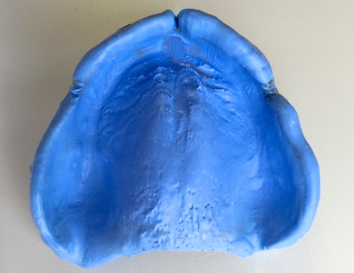
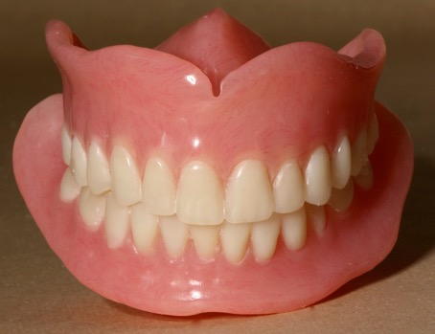
Maxillary Frena
Labial (narrow) and Buccal (wide)
  Must capture in impression, provide adequate relief in denture
Buccal
Labial

Slide 30
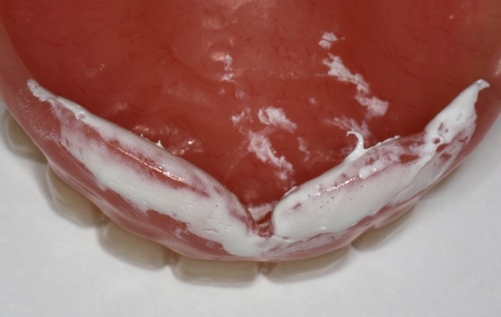
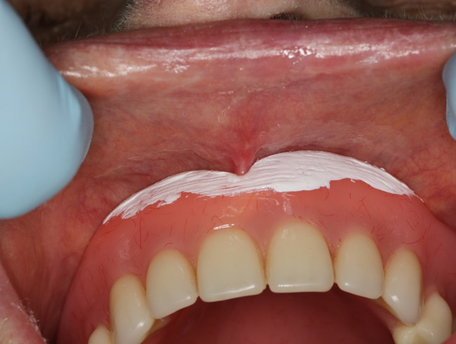
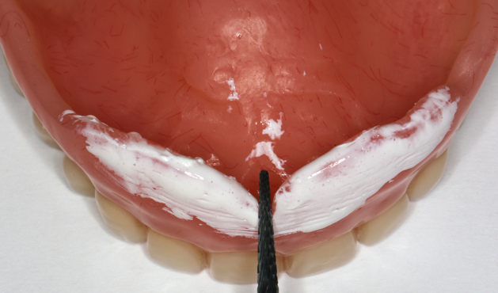
Maxillary Frena
  Use indicating media to identify impingement
Labial

Slide 31
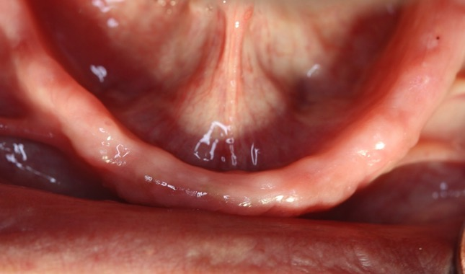
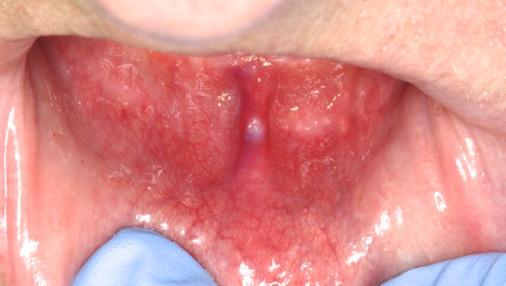
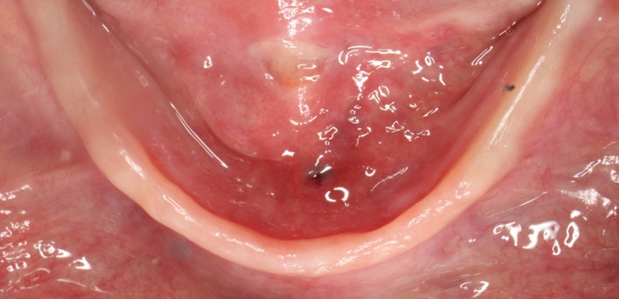
Mandibular Frenum
Labial, Buccal and Lingual
  Denture must provide relief, otherwise:
    Displacement
    Discomfort
    Ulceration
Lingual
Buccal
Labial Frenum Ulcer
Lingual Impingement

Slide 32
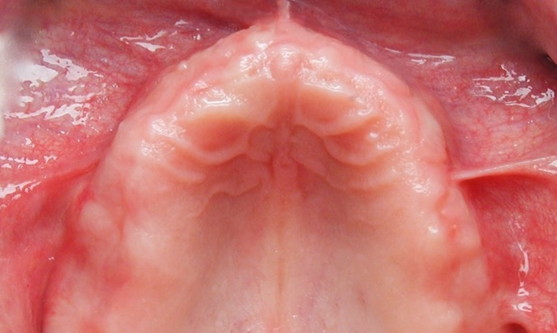
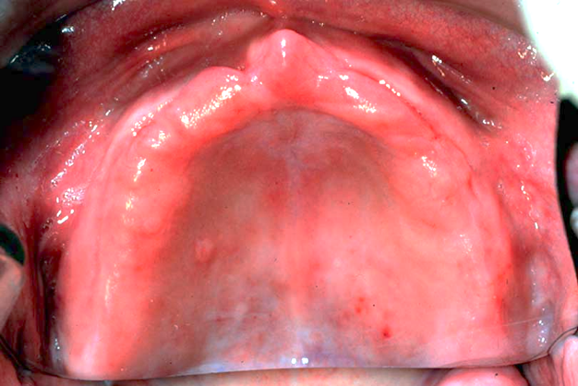
Maxilla
Incisive Papilla
  Landmark for setting of teeth
  Nerve can cause discomfort if insufficient relief

Slide 33


Mandible
Pear Shaped Pad
  Soft pad containing glandular tissue
  Inverted pear shape, posterior border
  Created from scarring after extractions

Slide 34

Mandible
External Oblique Ridge
  Do not extend dentures to this ridge

Slide 35


Mandible
Buccal Shelf
  Primary denture bearing area of mandibular denture
  Between height of ridge & external oblique ridge
  Resorbs more slowly

Slide 36

Cheeks
Masseter Muscle
  Closing muscle
  Not active during impression making

Slide 37

Masseter Muscle
  Not active for impressions
  During function (closure) gets rounder, bulging into posterior buccal vestibule
Open
Closed
Cross Sectional
Shape of Masseter

Slide 38


Masseter Muscle
  Have patient close against pressure in border molding stage
  If near the posterior flange, concavity will be present on flange
  If insufficiently captured, discomfort/ulcer

Slide 39

Mandible
Anterior Border of the Ramus
  Do not extend dentures to ramus
  Discomfort will result

Slide 40


Mandible
Mylohyoid Ridge
  Origin of mylohyoid muscle which influences length of lingual flange

Slide 41

Mandible
Mylohyoid Ridge
  Can be prominent, and/or sharp, requiring relief

Slide 42


Mandible
Floor of Mouth
  If moves dramatically, can affect
    Retention
    Comfort

Slide 43

Mandible
Lingual Tori
  Raised bony exostoses frequently in premolar region
  May require relief when covered by a denture
  Thin mucosa can ulcerate easily

Slide 44


Mandible
Genial Tubercles
  Attachment for the genioglossus muscle
  Tubercles may be higher than the ridge with severe resorption

Slide 45


Frena (singular = frenum)
Must be relieved to allow movement, without impingement
If prominent, adequate relief can weaken a denture
If too much relief, retention is lost
Check prominence intraorally

Slide 46

Pterygo-Mandibular Raphe
Connects from the hamulus to the mylohyoid ridge
When prominent, can cause pain, or loosening
Requires relief “groove ” if prominent

Slide 47

Retrozygomal Fossae (Space)
Palpate zygomatic process in buccal vestibule just buccal to first maxillary molar
Vestibular space posterior to zygoma

Slide 48

Retrozygomal Fossae (Space)
Commonly incompletely captured in preliminary impressions
Use syringe technique

Slide 49

Coronoid Process
Place mirror head lateral to tuberosity
Move mandible to opposite side
Note binding or pain
This gives some indication of the width of the space for flange

